Slide 1


Slide 2

Phi-3.5 is coming

Slide 3
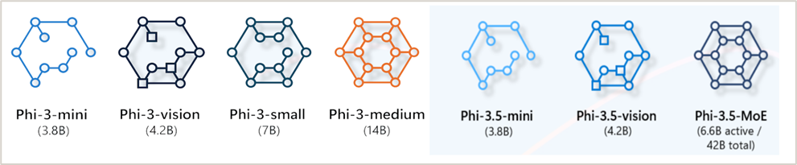
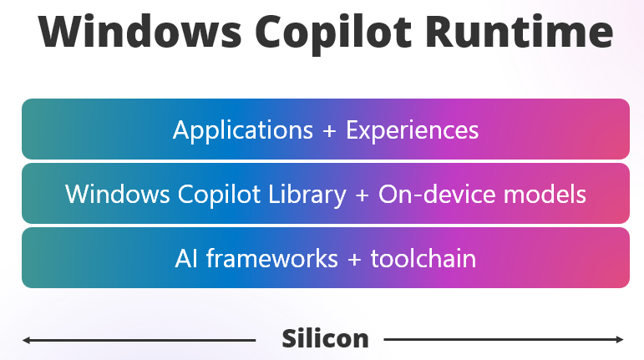





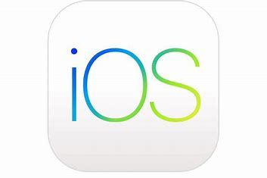


The opportunity of SLMs apps and devices
Small Language Models
On Cloud
On Edge
Mobile • Edge
(iOS, Android)
aka.ms/wcr

Slide 4
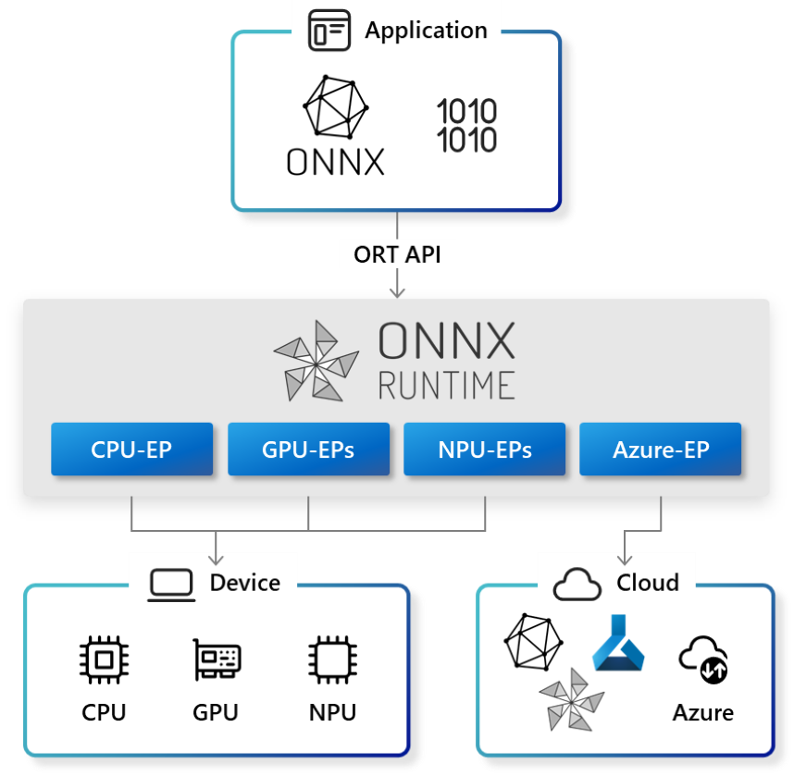



Optimization and performance ONNX runtime
Application
Execution provider
Company
Azure​ | Microsoft​
QNN​ | Qualcomm​
OpenVino​ | Intel​
Vitis​ AI | AMD​
DirectML​ | Microsoft​
WebNN​ | Microsoft, Intel​
ONNX
Runtime
CPU-EPs
GPU-EPs
NPU-EPs
ORT Web
Azure-EP
Device
Cloud
Azure
CPU
GPU
NPU

Slide 5
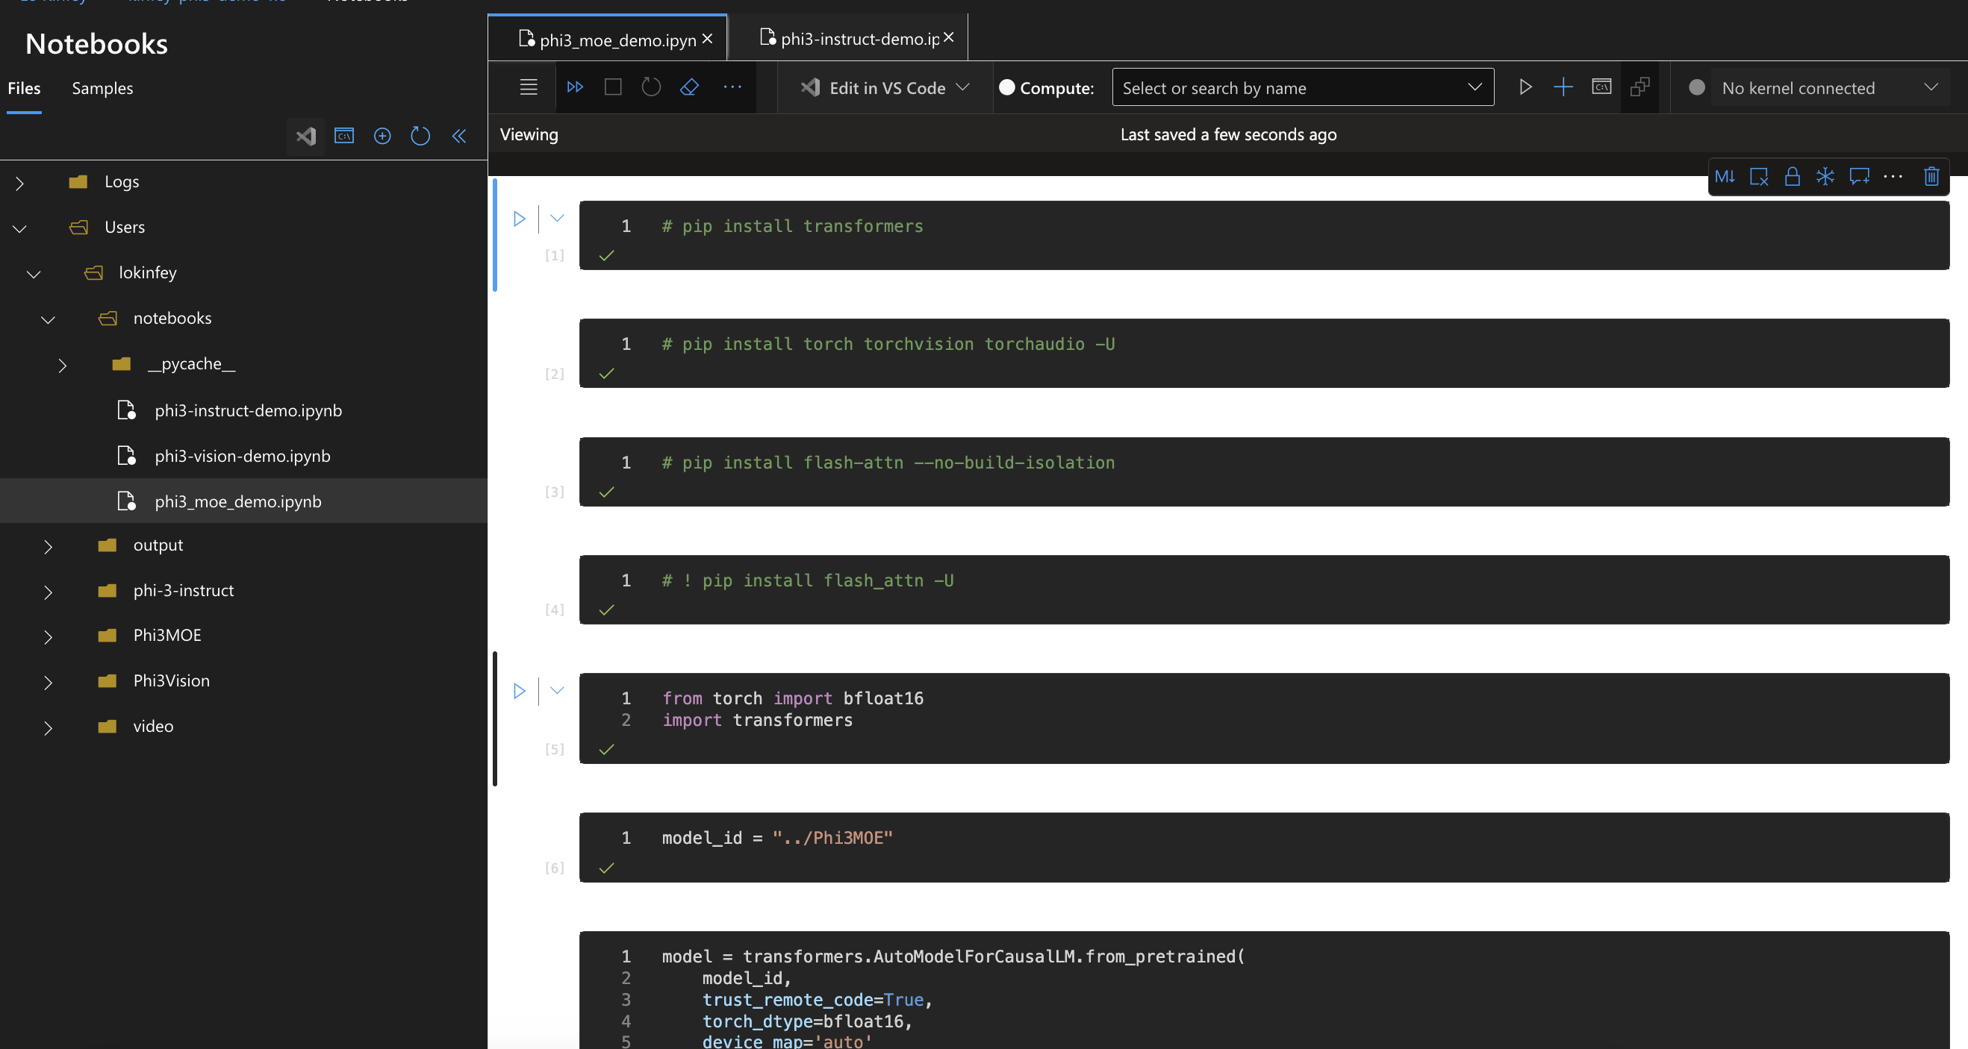
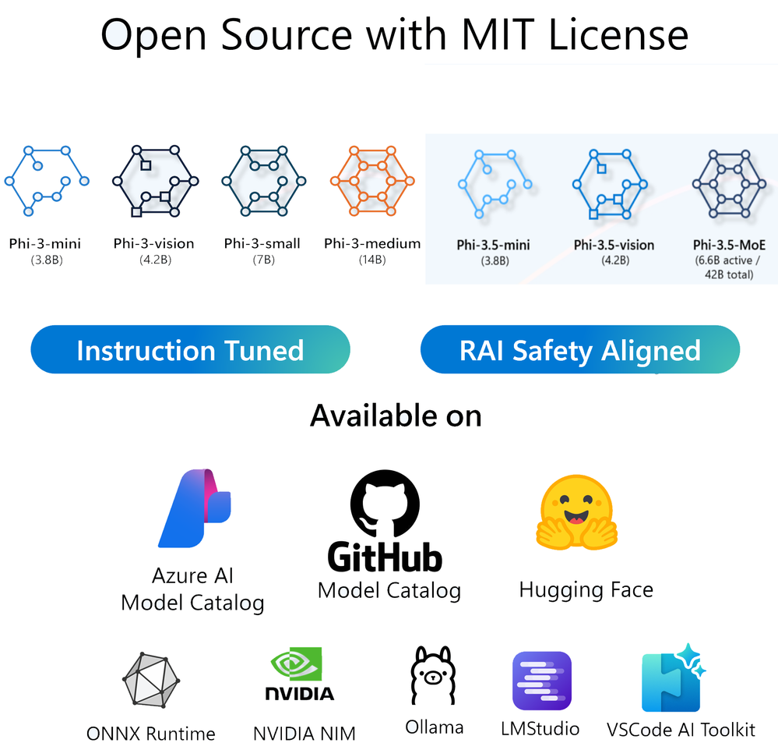
DEMO

Slide 6

GitHub Models

Slide 7
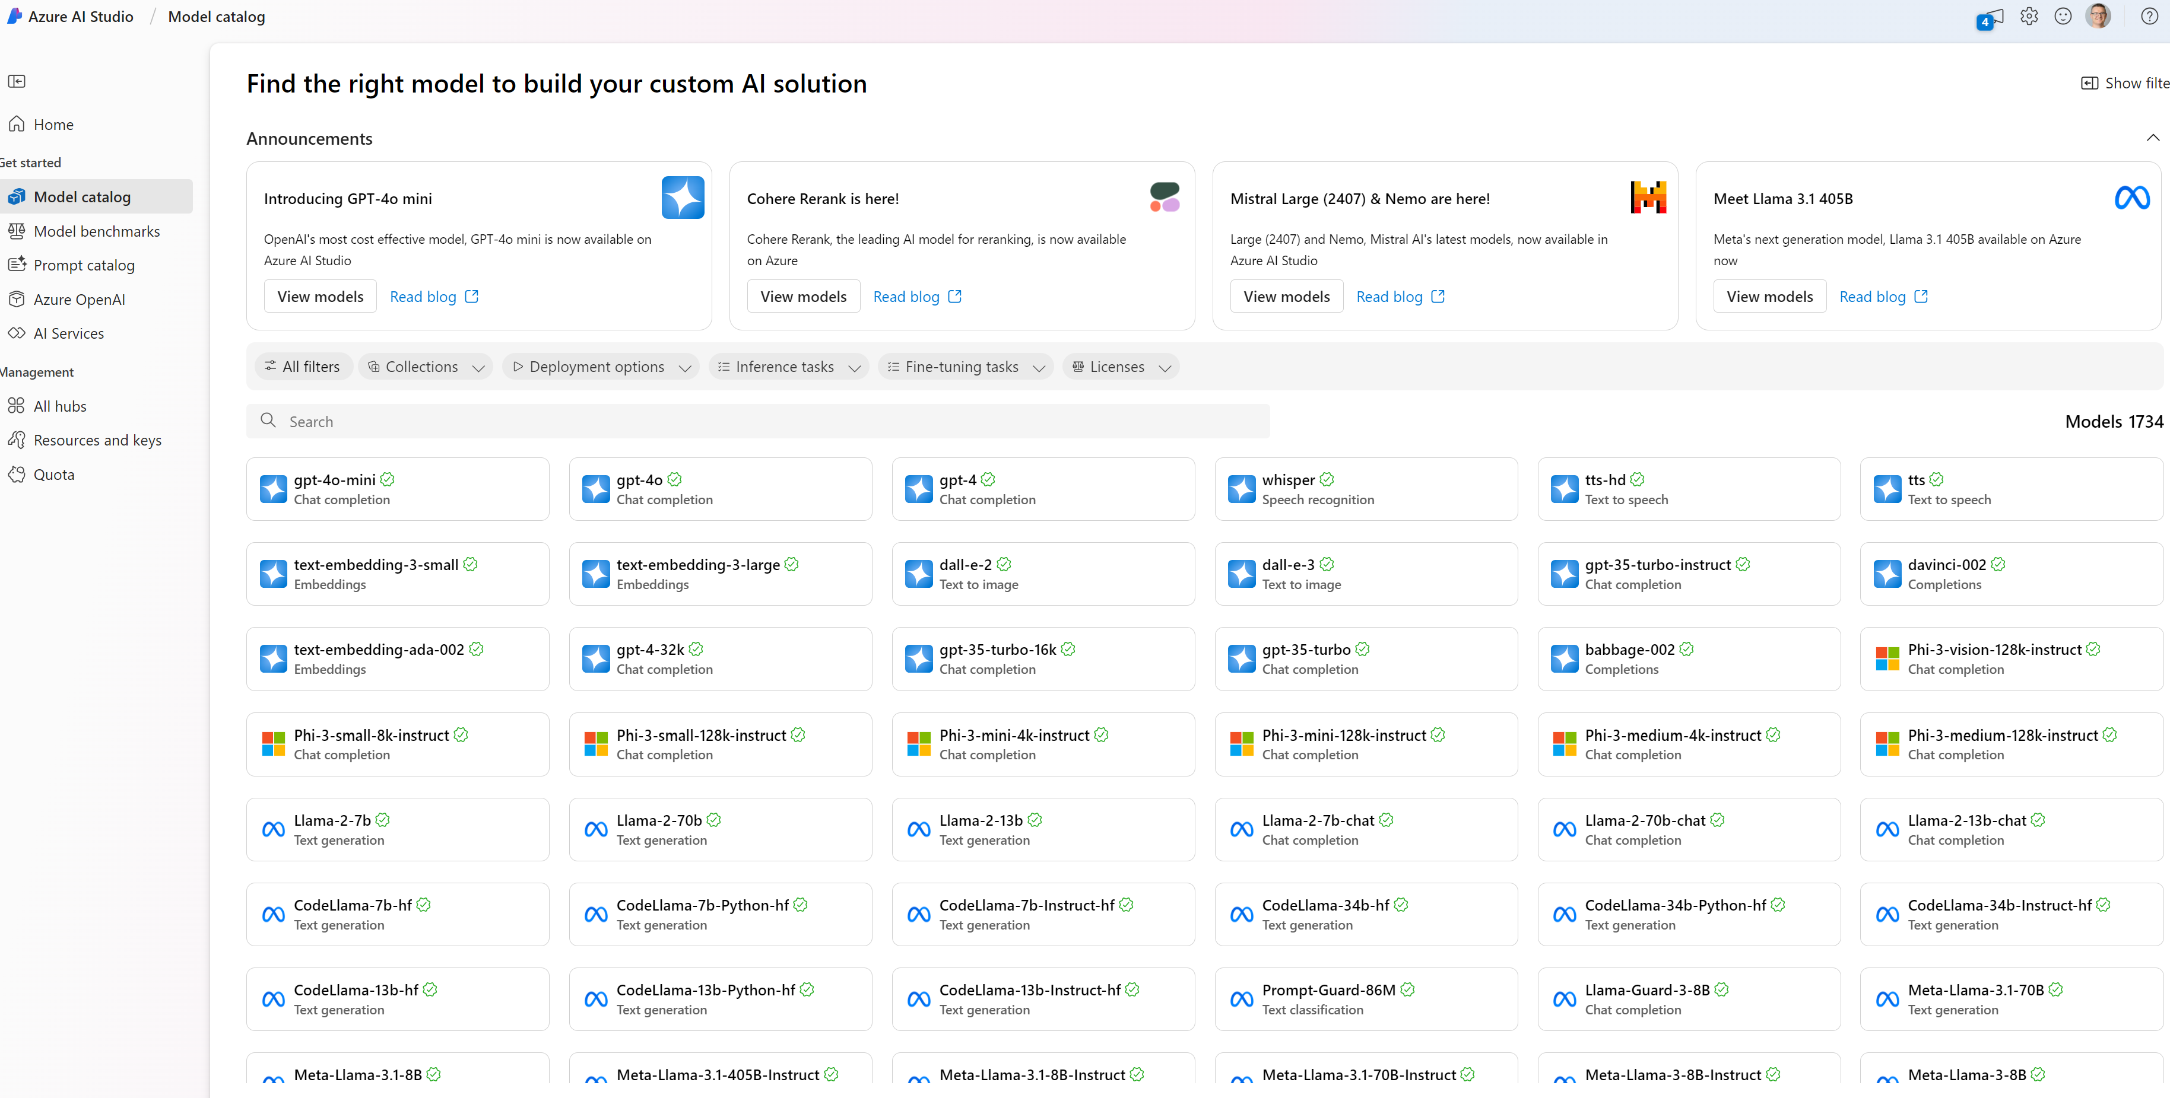
Azure Model Card and Playground

Slide 8
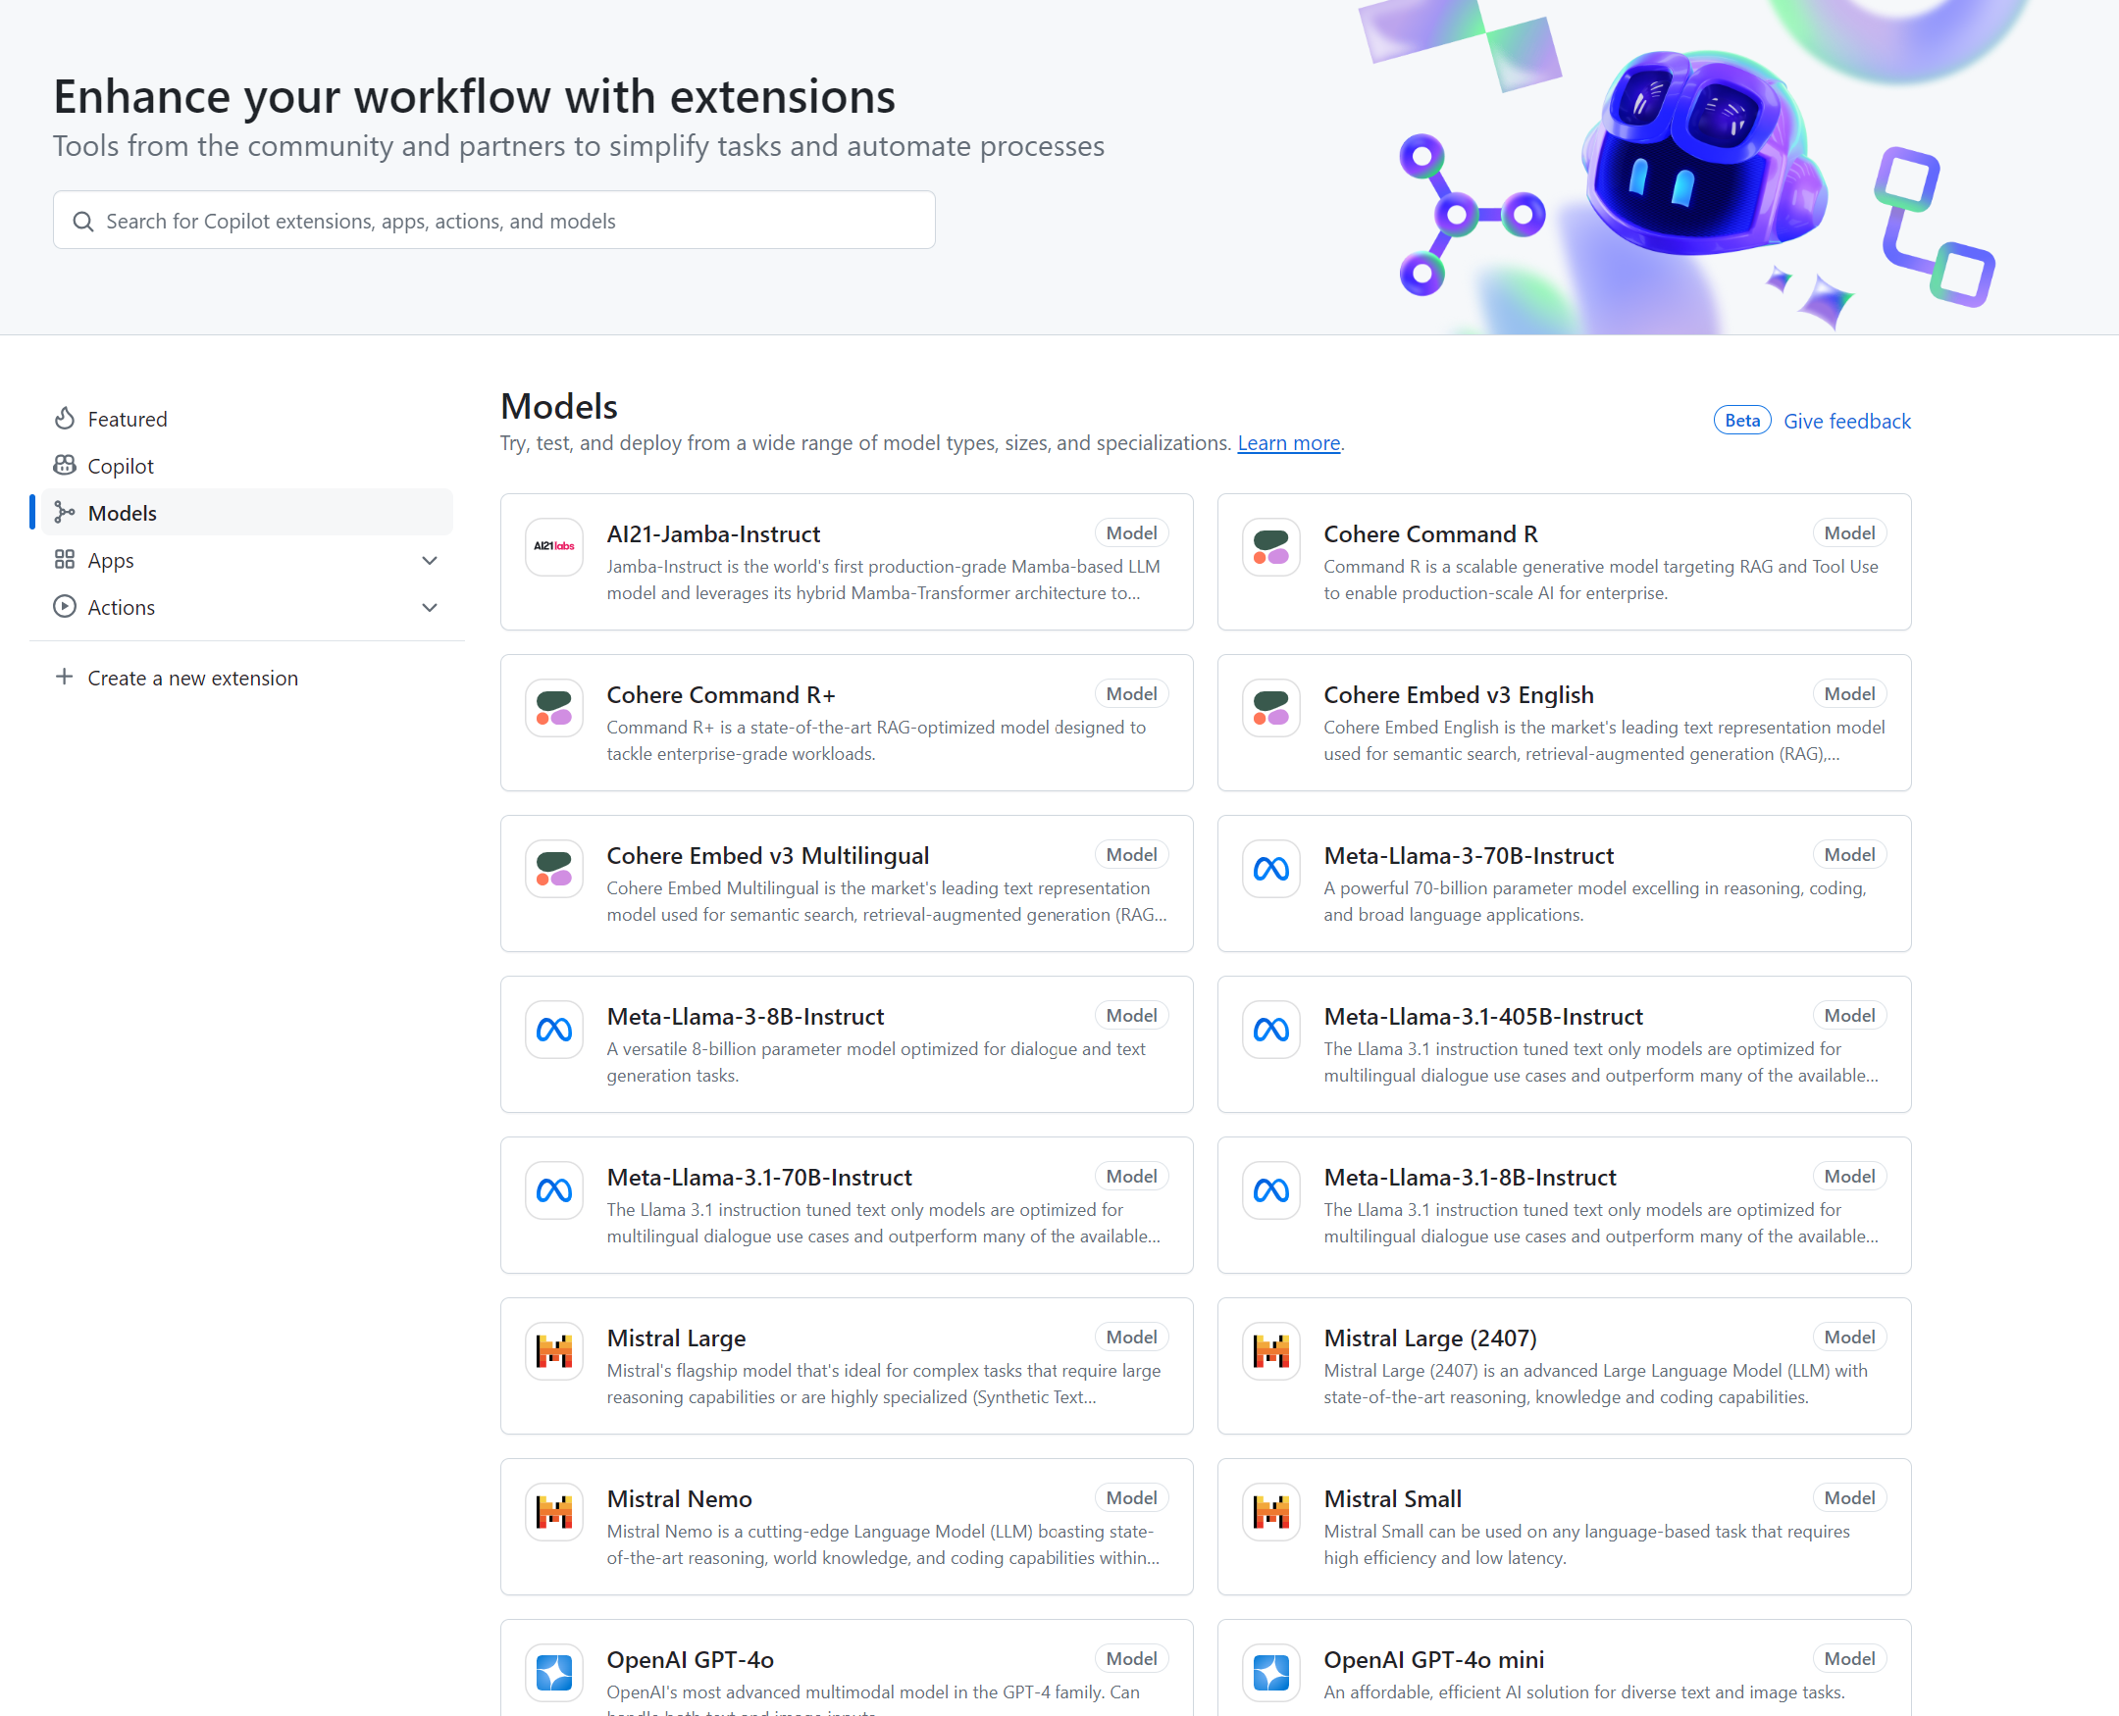
GitHub Model Card and Playground

Slide 9


Comparing model and prompt outcomes
GPT4 Prompt: Generate a prompt for a hyper realistic portrait of a pirate
hyper realistic portrait of a pirate, grizzled beard, weathered skin, eye patch, tricorn hat, gold earning, dramatic ocean backdrop, sunset, nikon D850, 85mm lens 1/1.8, intense contrast, vivid colours, shallow depth of field -v.5,-q2, --ar4:5
Concise prompt, not fine-tuned for conversation
GPT3.5 Prompt: Generate a prompt for a hyper realistic pirate of a pirate
A rugged pirate captain stands on the deck of his ship, looking out at a vast and stormy sea. He sports a flowing black beard and tattoos on both arms, with a single gold hoop earring in his left ear. His clothing is made up of mismatched layers of leather and wool, giving him both an imposing and weathered appearance. The sky behind him is tumultuous, with forked lighting flashing in the distance. This image is designed to be hyper-realistic, 8K resolution,
Similar, but more verbose, Less complex LLM, Tuned for conversation

Slide 10


Compare the results
GPT 4 Prompt
GPT 3.5 Prompt

Slide 11
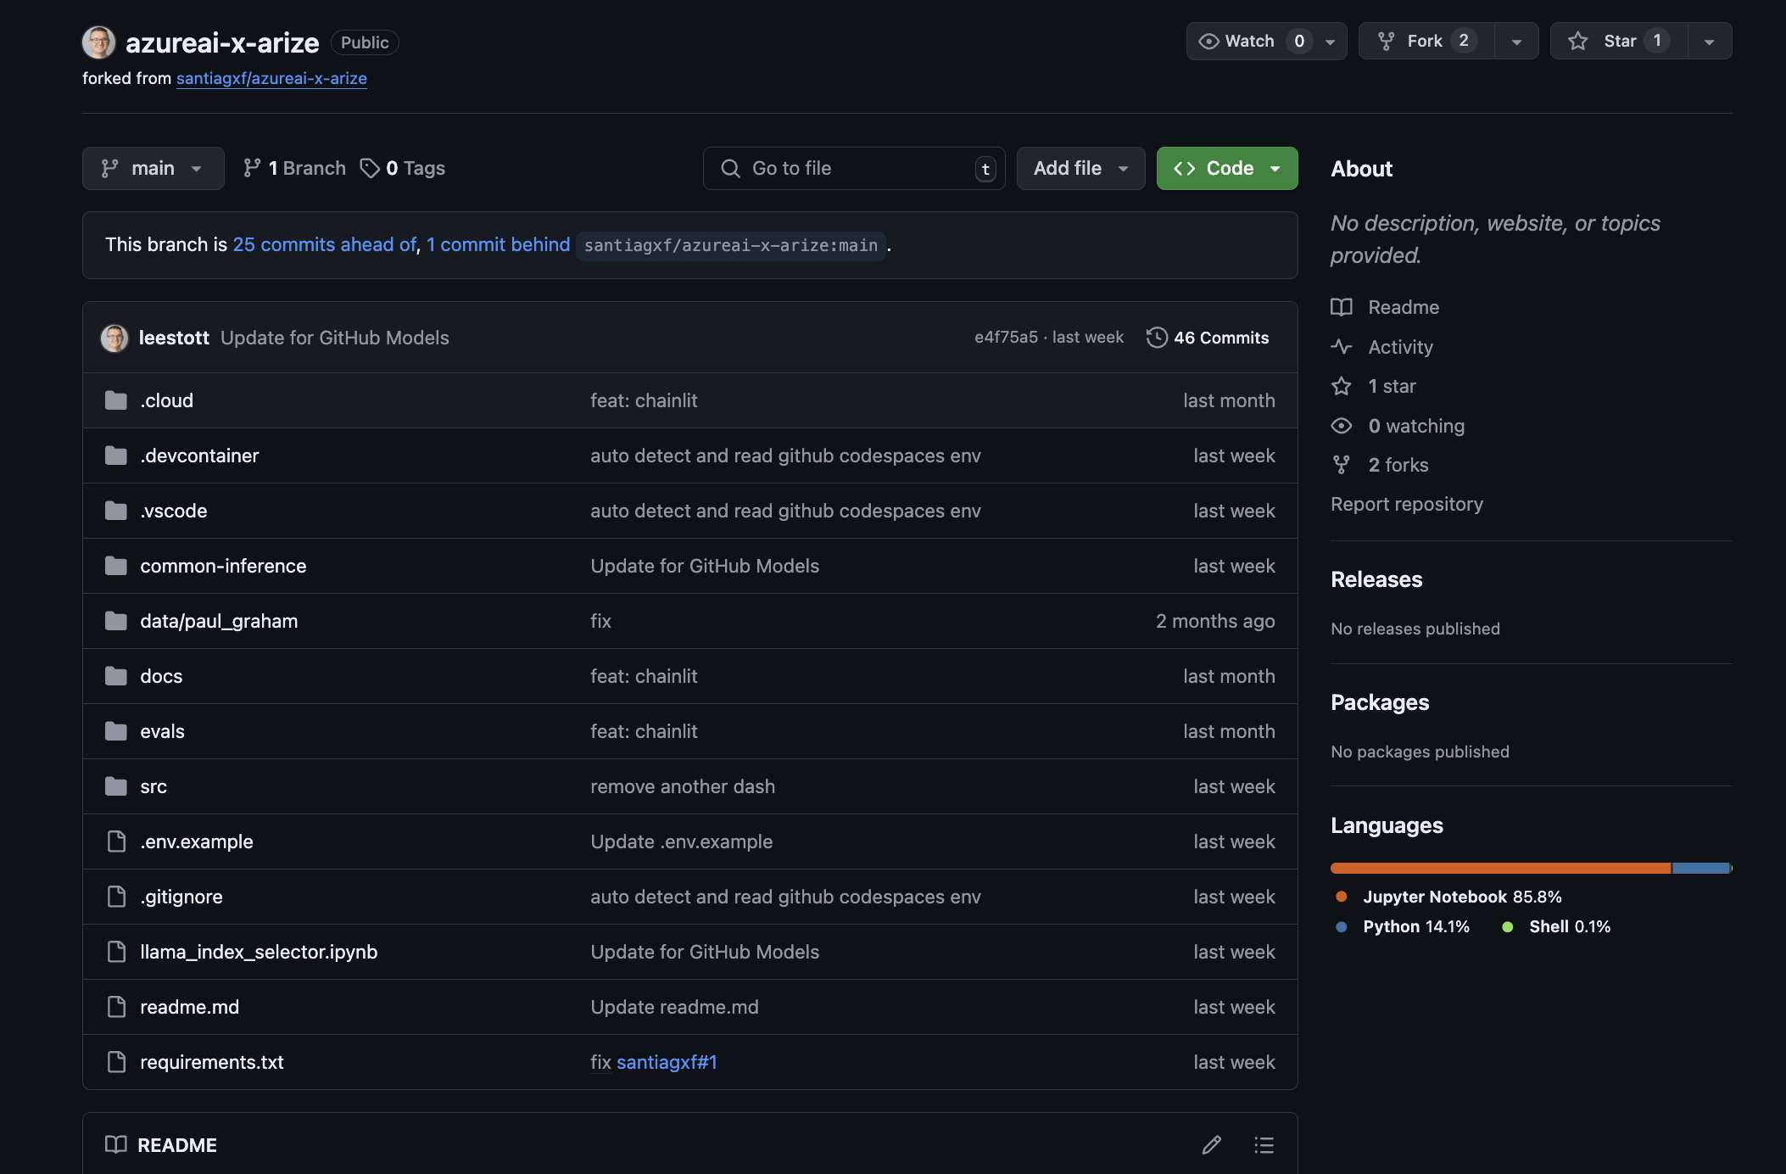
DEMO
https://github.com/leestott/azureai-x-arize

Slide 12

DEMO

Slide 13
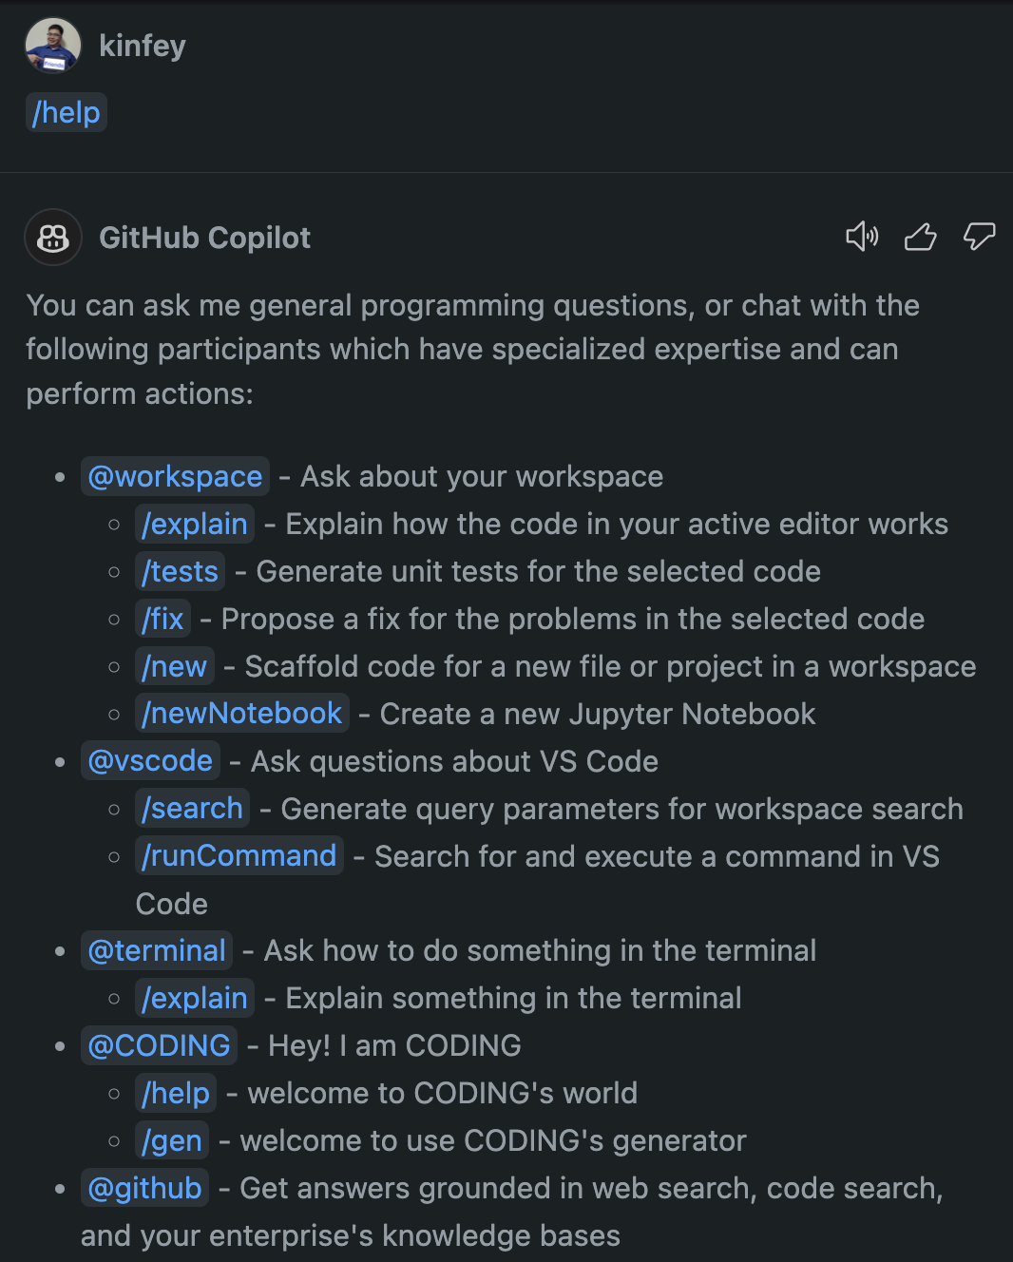
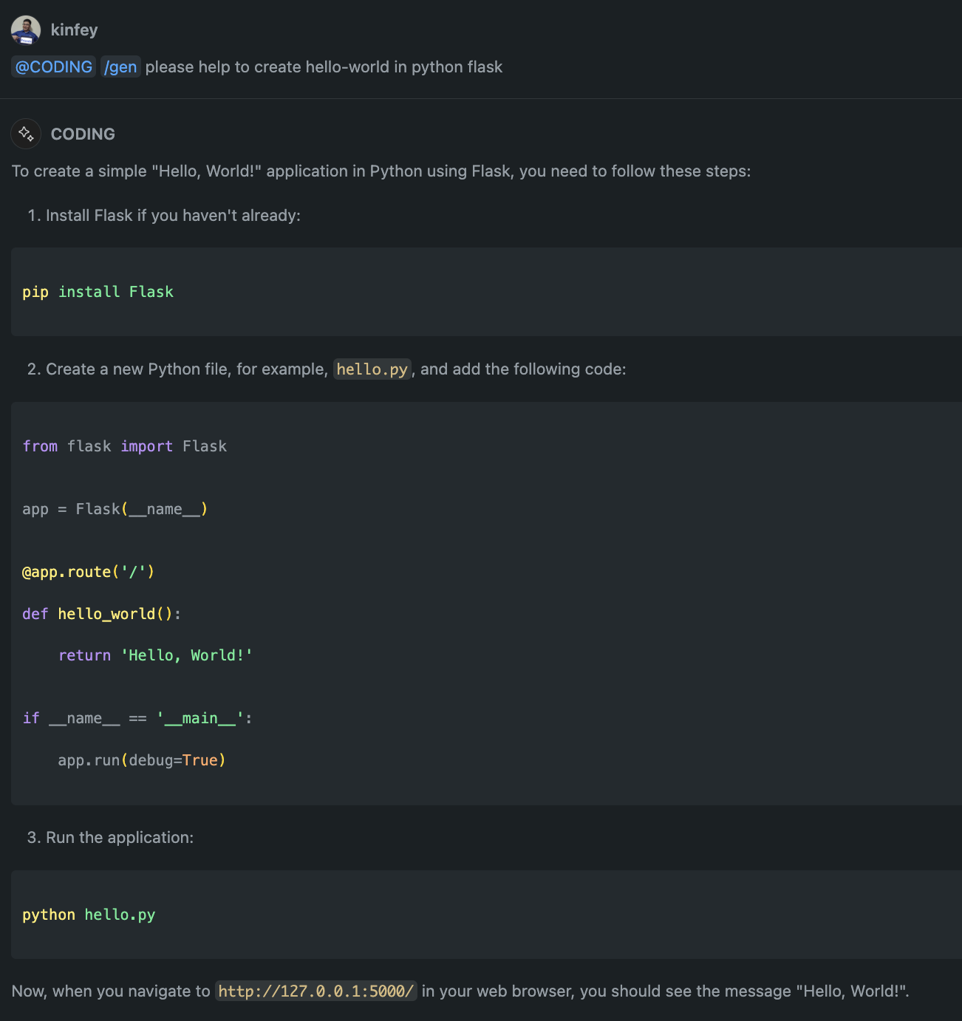

DEMO

Slide 14


Azure AI Studio
A unified platform for developing generative AI apps and custom copilot experiences
Unified Platform
Multimodal AI Tools Code-centric Developer Experiences
Data Integration
Ground models using your own data
Microsoft Fabric
Hybrid & Semantic Search
Retrieval Augmented Generation (RAG)
Vector support
Full Development Lifecycle
Model Catalog
Prompt flow
LLMOps
Safe & Responsible AI
Content Classification
Model Monitoring
Jailbreak Risk Detection
Explore, build, evaluate, and deploy AI responsibly

Slide 15


AI Studio
Copilot Studio
Machine Learning
Studio
AOAI Studio
4 Spiderman pointing at each other Blank Template - Imgflip

Slide 16
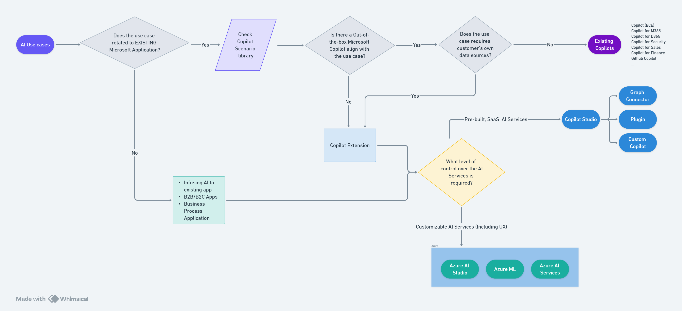

Slide 17

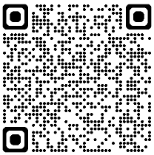
Assumption & Reminder
Microsoft provides the tooling and platform to keep track of the measurable metrics for the GenAI app.
It is the responsibility of partners and customers to define the acceptance criteria of the GenAI app before the UAT and Production golive.
Use objective measurable metric, rather than subjective feeling.
Make sure your customer understand the nature of Gen AI is non-deterministic . If they expect exact same answer is returned every time for the same question, they should consider other AI services like custom question answering. Or you can try this preview feature of AOAI

Slide 18
3 Pillars
Evaluation: manual and auto
Monitoring: performance and safety
Logging: chat history, app log, chargeback

Slide 19
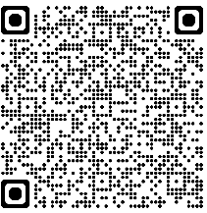
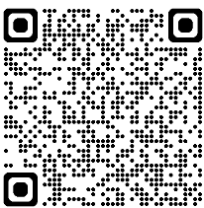
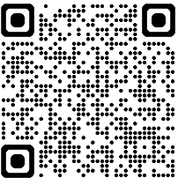

Experience Sharing – the 5 Step
Drive test cases from requirement spec. (eg. 10 requirements)
Define max number of questions for each requirement. (e.g. 3 questions for each requirement, ie. 3 x 10 = 30). Prepare the test dataset.
Define the relevant metrics (e.g. groundedness, relevance, latency) and agree on the acceptance criteria. Enable tracing
Iteration: Execute the test cases, evaluate, analyse and keep track the metric
Continuous monitoring after golive

Slide 20
1. Ideating/exploring
2. Building/augmenting
3. Operationalizing
Identify business use case
Run flow against sample data
Run flow against larger dataset
Deploy endpoint
Discover your model
Manual:
Evaluate prompt flow
Automated:
Evaluate prompt flow using metrics like groundedness, relevance
Add monitoring and alerts
Test sample prompt
Modify flow (prompts and tools, etc.)
Integrate into application
Connect to your data and build LLM flows
Satisfied?
Yes
Satisfied?
Yes
No
No

Slide 21
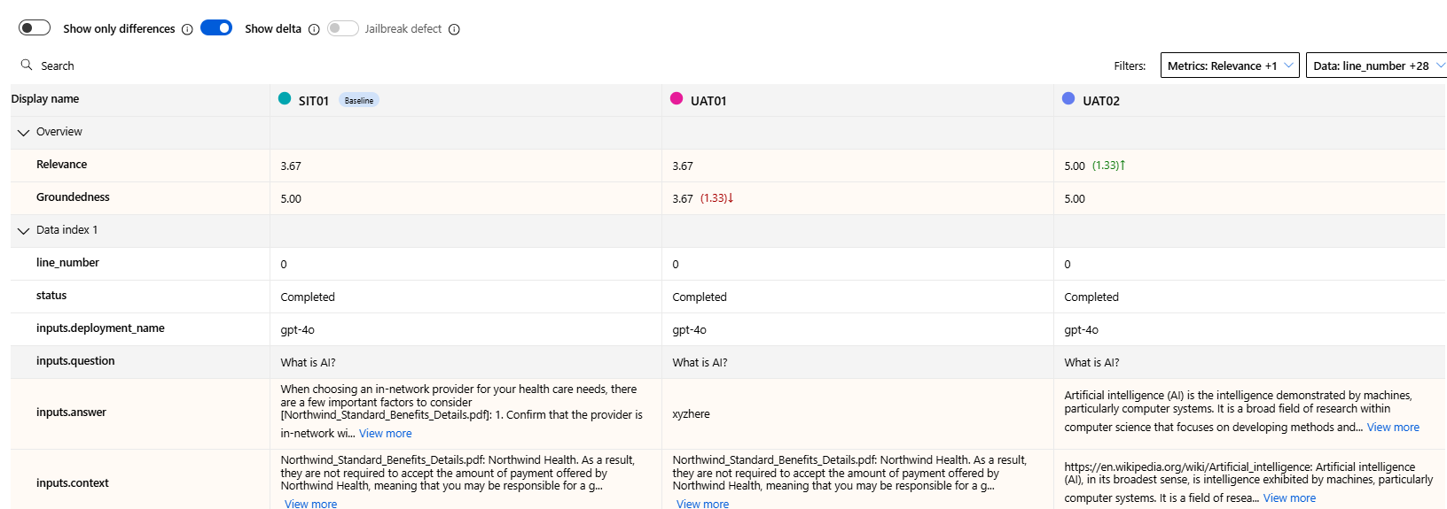
From feeling to number

Slide 22
Detailed Example
Agree test scope and acceptance criteria upfront
Manual evaluation to test the water
Prepare test dataset (CSV/JSON), select the automated evaluation metric and execute (Batch #1)
Review the evaluation result (batch #1)
Make changes to improve the model outcome (e.g. add data source, review search index, inspect chunking method, update system message, update AOAI API parameter etc)
Make multiple changes when required and compare results across multiple evaluation runs (e.g. Batch #2 to #10)
Regularly demo the improvement over time (e.g. weekly sprint) to business stakeholders and compare against the acceptance criteria
Use Azure Monitor, App Insight, chat history, AI SDK, AI content safety etc as the continuous monitoring after golive

Slide 23

Generative AI Metrics for Evaluation
Metric | Description | When to Use
Groundedness | Evaluates how well the model's generated answers align with information from the input source. | You're worried your application generates information that isn't included as part of your generative AI's trained knowledge (also known as unverifiable information)
Relevance | Measures the extent to which the model's generated responses are pertinent and directly related to the given questions. | You would like to achieve high relevance for your application's answers to enhance the user experience and utility of your generative AI systems
Coherence | Measures the quality of all sentences in a model's predicted answer and how they fit together naturally. | You would like to test the readability and user-friendliness of your model's generated responses in real-world applications.
Fluency | Evaluates the language proficiency of a generative AI's predicted answer. It assesses how well the generated text adheres to grammatical rules, syntactic structures, and appropriate usage of vocabulary, resulting in linguistically correct and natural-sounding responses. | You would like to assess the grammatical and linguistic accuracy of the generative AI's predicted answers.
Ada Similarity | Quantifies the similarity between a ground truth sentence (or document) and the prediction sentence generated by an AI model. | You would like to objectively evaluate the performance of an AI model (for text generation tasks where you have access to ground truth desired responses). Ada similarity allows you to compare the generated text against the desired content

Slide 24
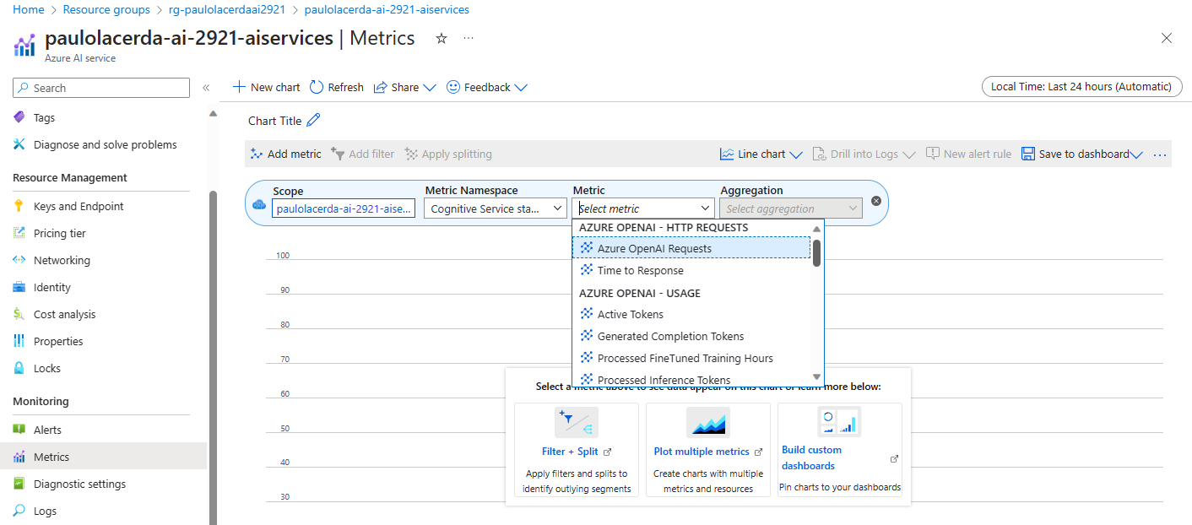
Operational metrics services monitoring

Slide 25
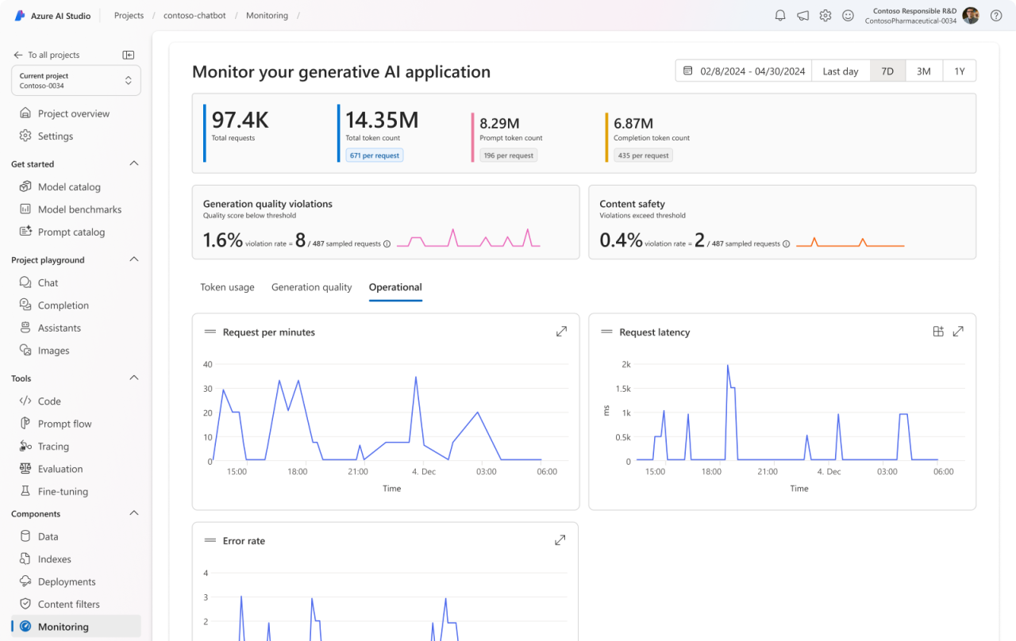
Generative AI monitoring
Helps you track and improve the performance of LLM applications in production
Key benefits
Utilize the Azure AI instrumentation SDK for effortless production data logging ​
Enable monitoring for operational (error rate, latency)l, token and cost (token usage), quality (groundedness, coherence, etc) metrics​ for prompt flow deployments
View extensive monitoring results for your prompt flow deployment within a comprehensive UI

Slide 26
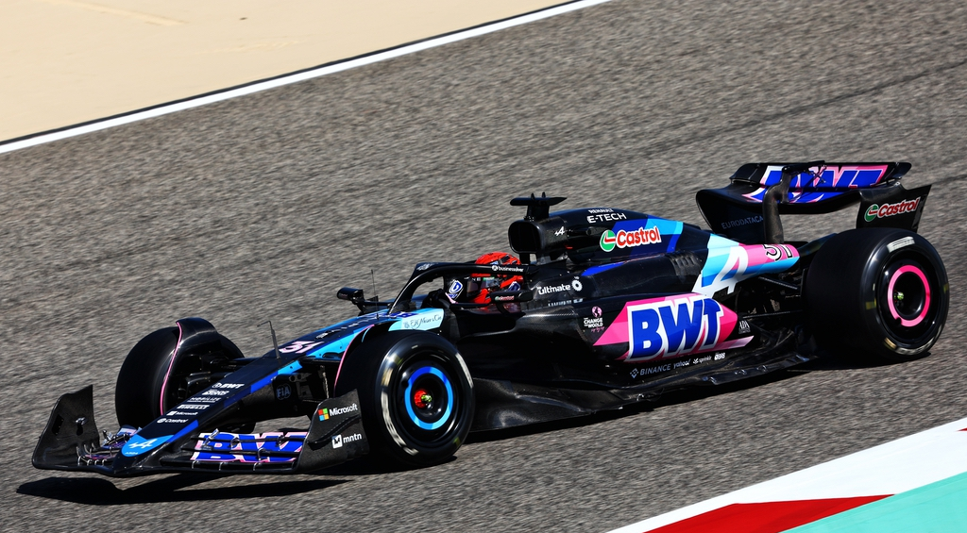
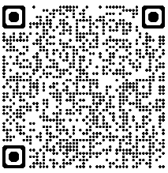

Tips for Maximizing Performance of GenAI applications
Minimizing the latency of GenAI applications is key to creating a great customer experience.
This article contains techniques for reducing the latency of GenAI applications. The linked code repository contains practical guidance showing how to implement these techniques, and a few case studies showing them in context.

Slide 27


LLMOps Workshop
c
b
a
Maximize your mastery of LLMOps!
Join our expert-led workshop to seamlessly build, deploy, evaluate, monitor and automate LLM App delivery using Azure AI.
Flexible Learning Paths: Tailored content for all proficiency levels – from no-code beginners to full-code experts, with hands-on labs and flexible delivery options.
Ask me anything…
Practical and Interactive: Engage with conceptual lessons and live lab exercises, with options for instructor-led demos to maximize learning without impacting the course flow.
https://aka.ms/llmops-workshop

Slide 28
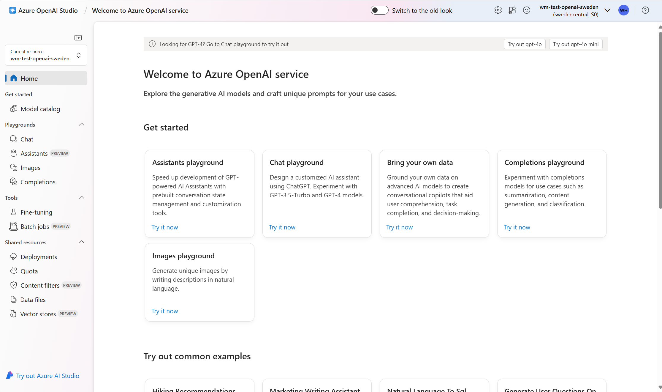

Slide 29
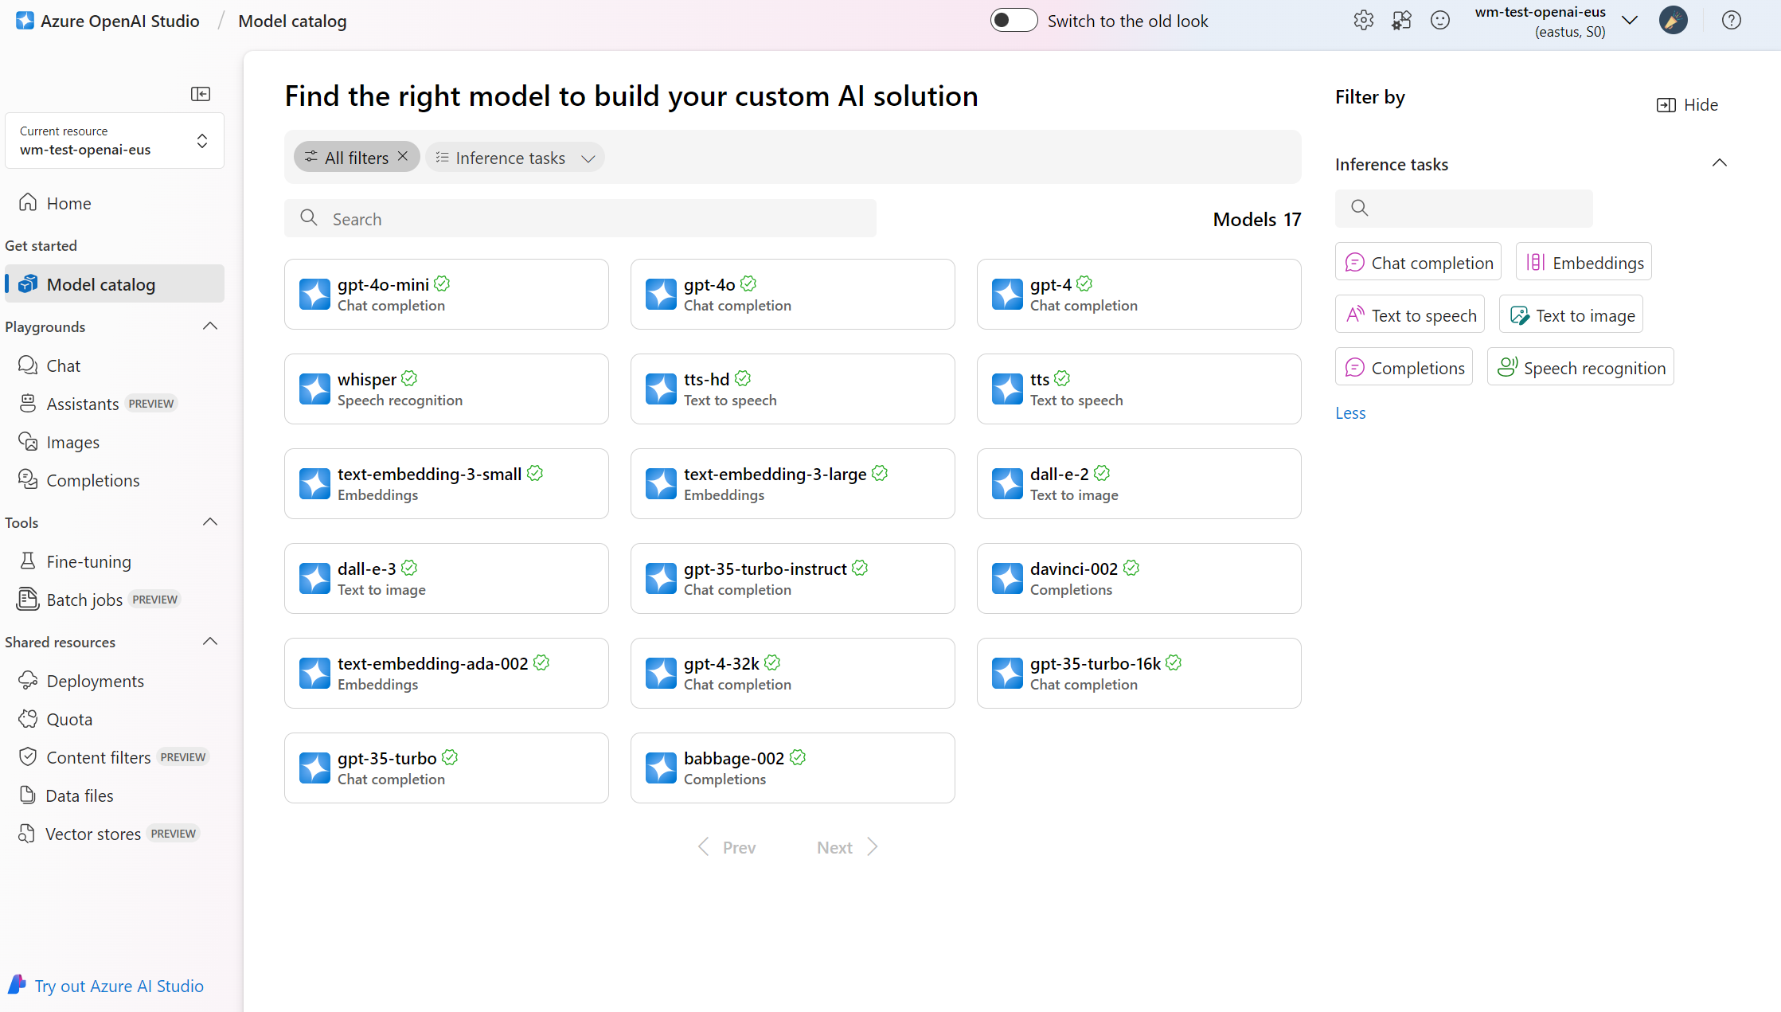

Slide 30
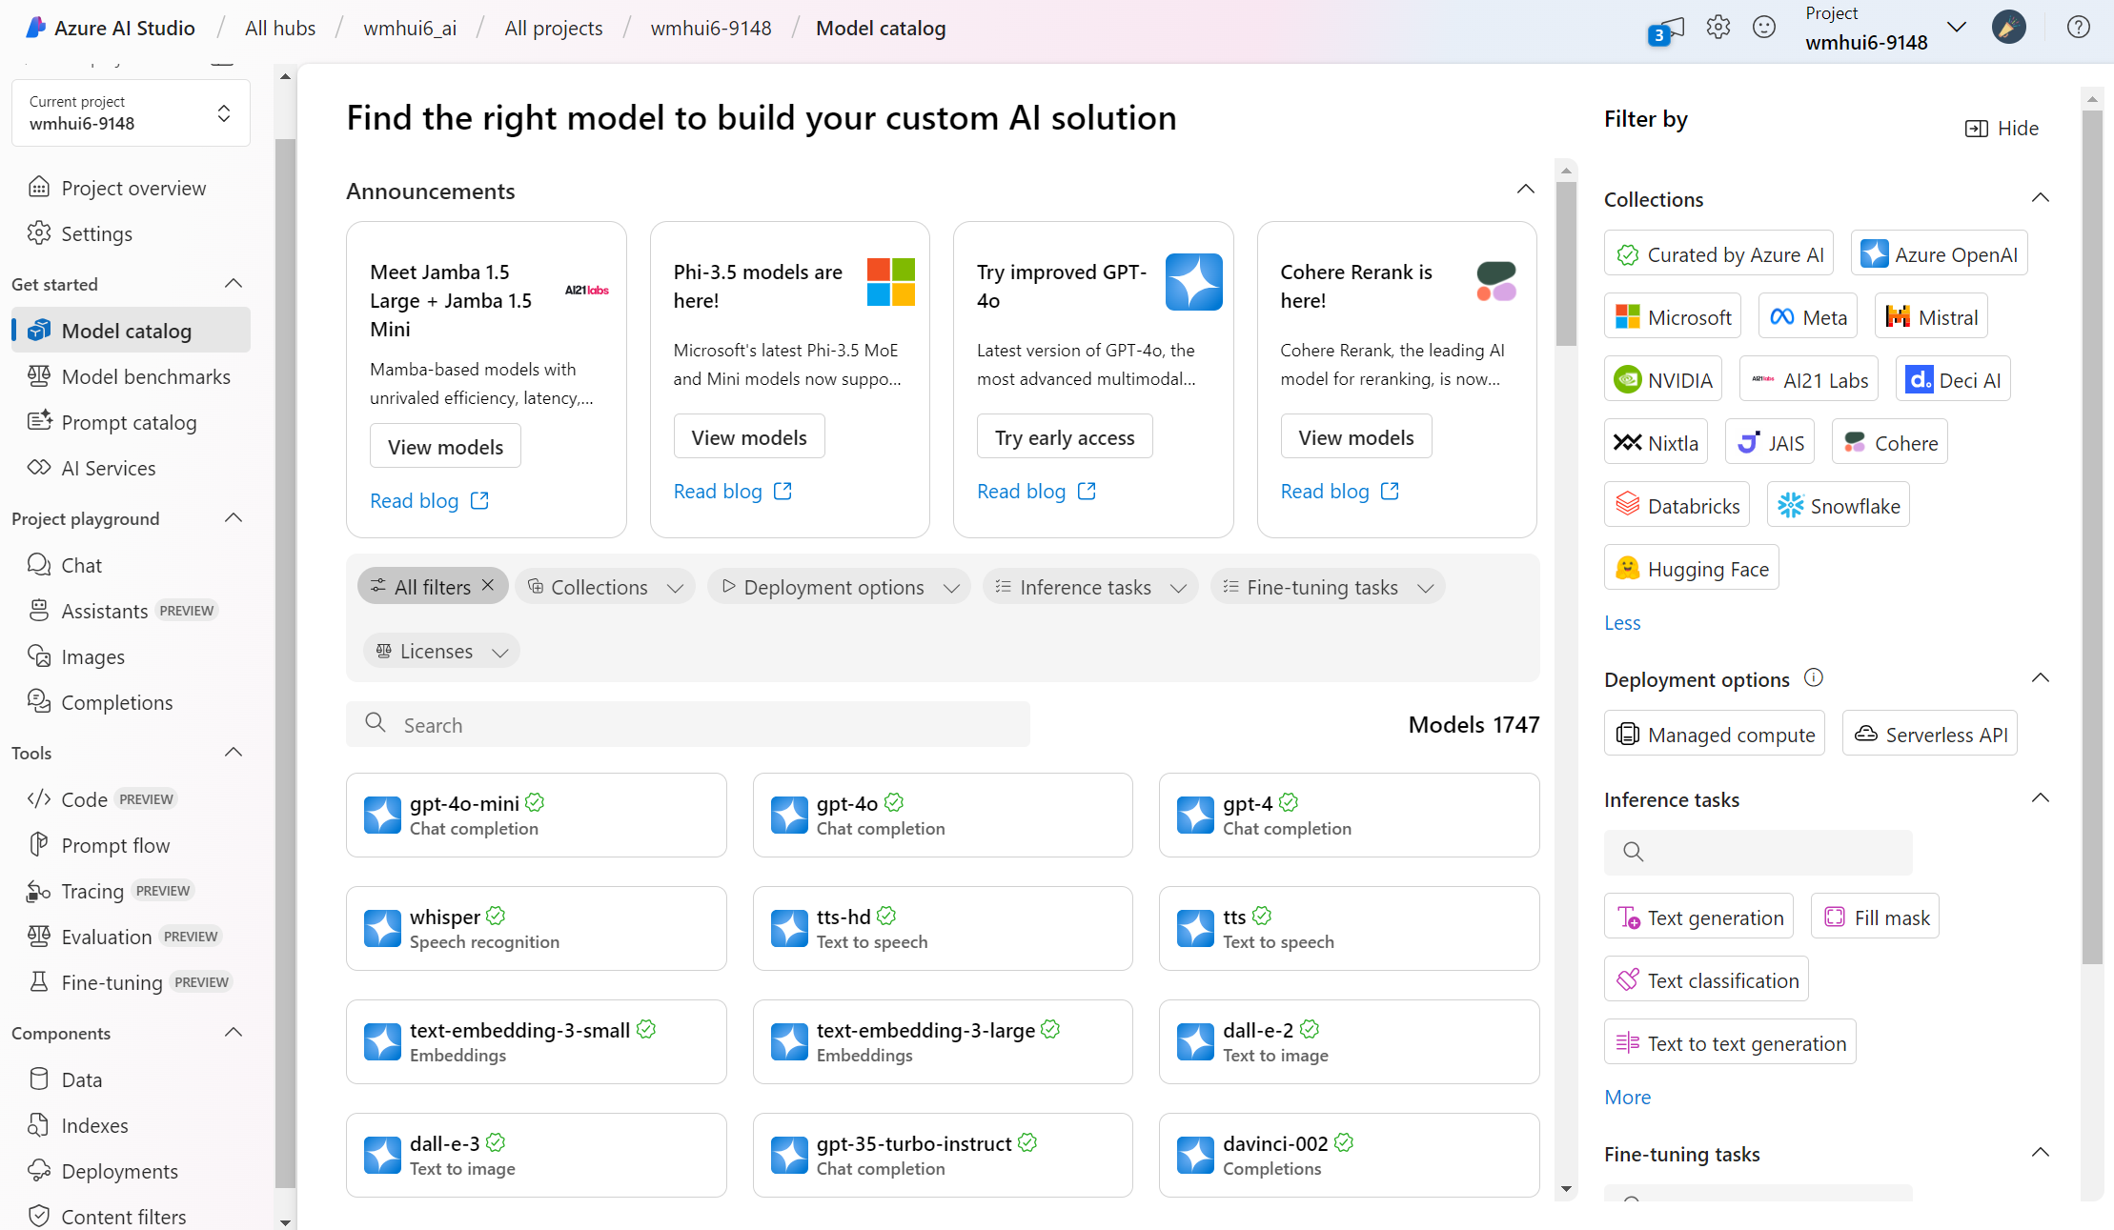

Slide 31
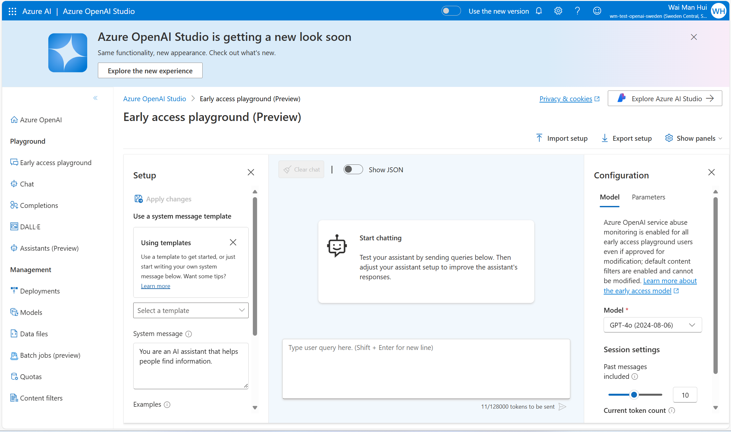

Slide 32
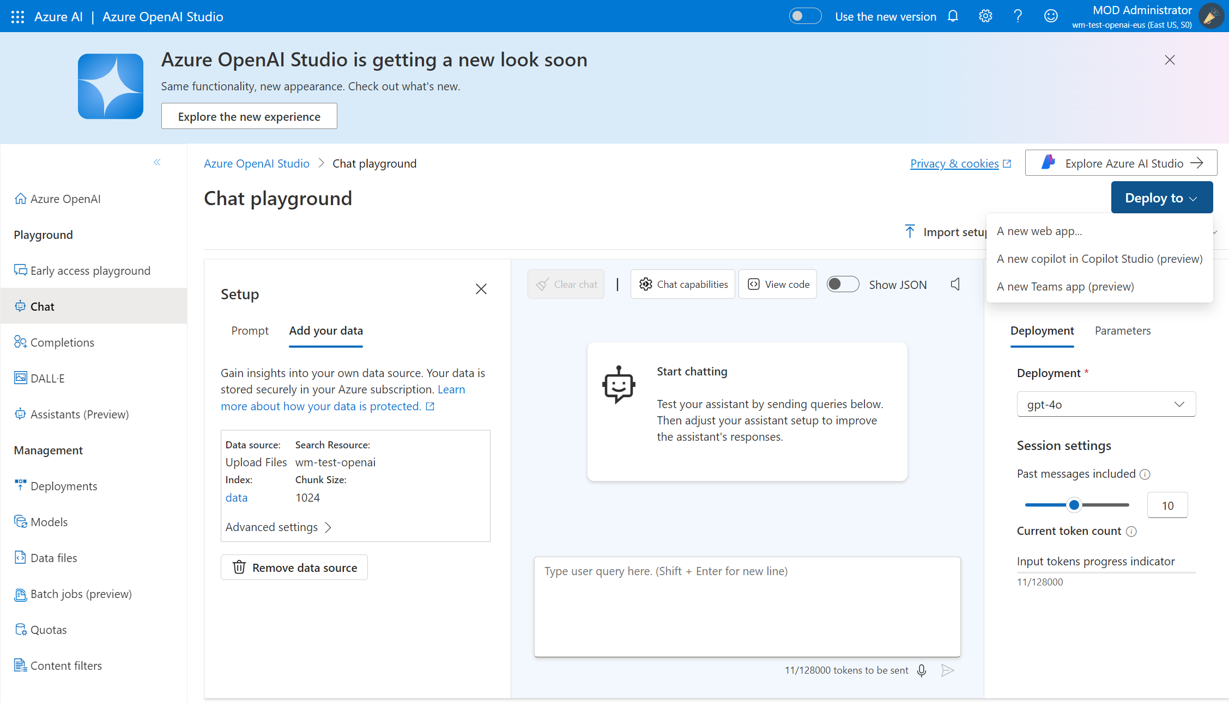

Slide 33
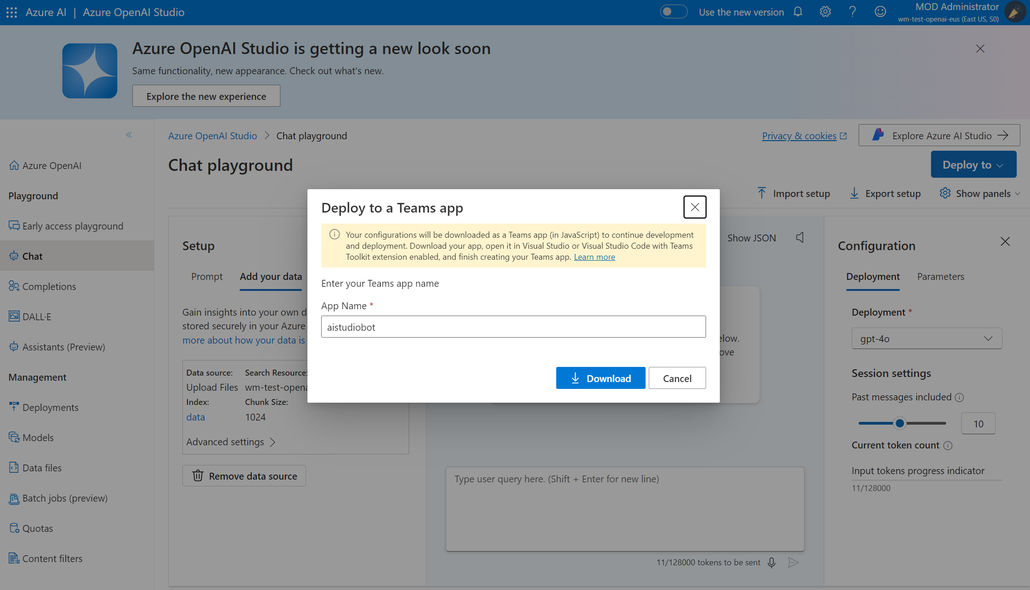

Slide 34
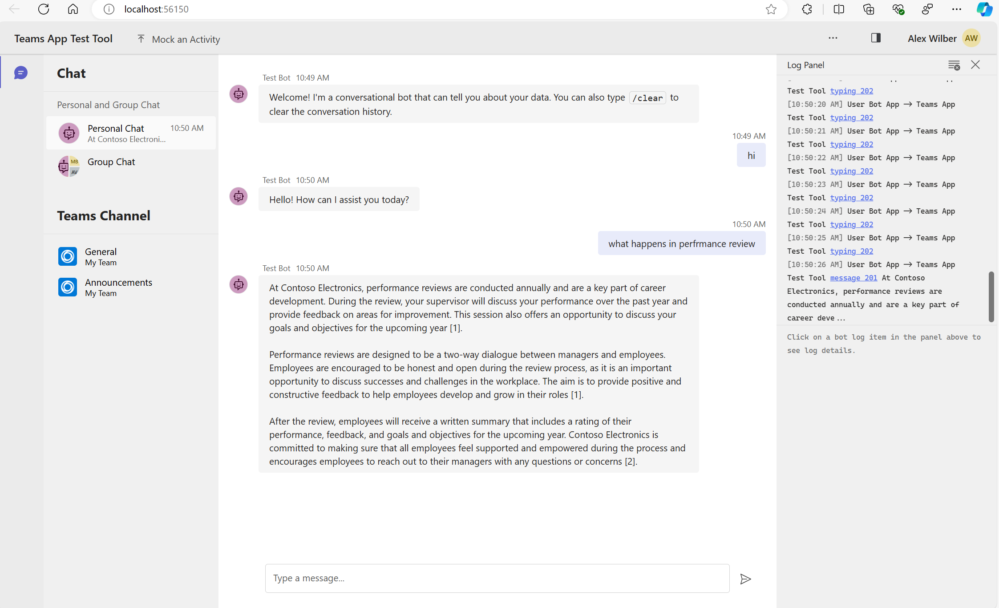

Slide 35
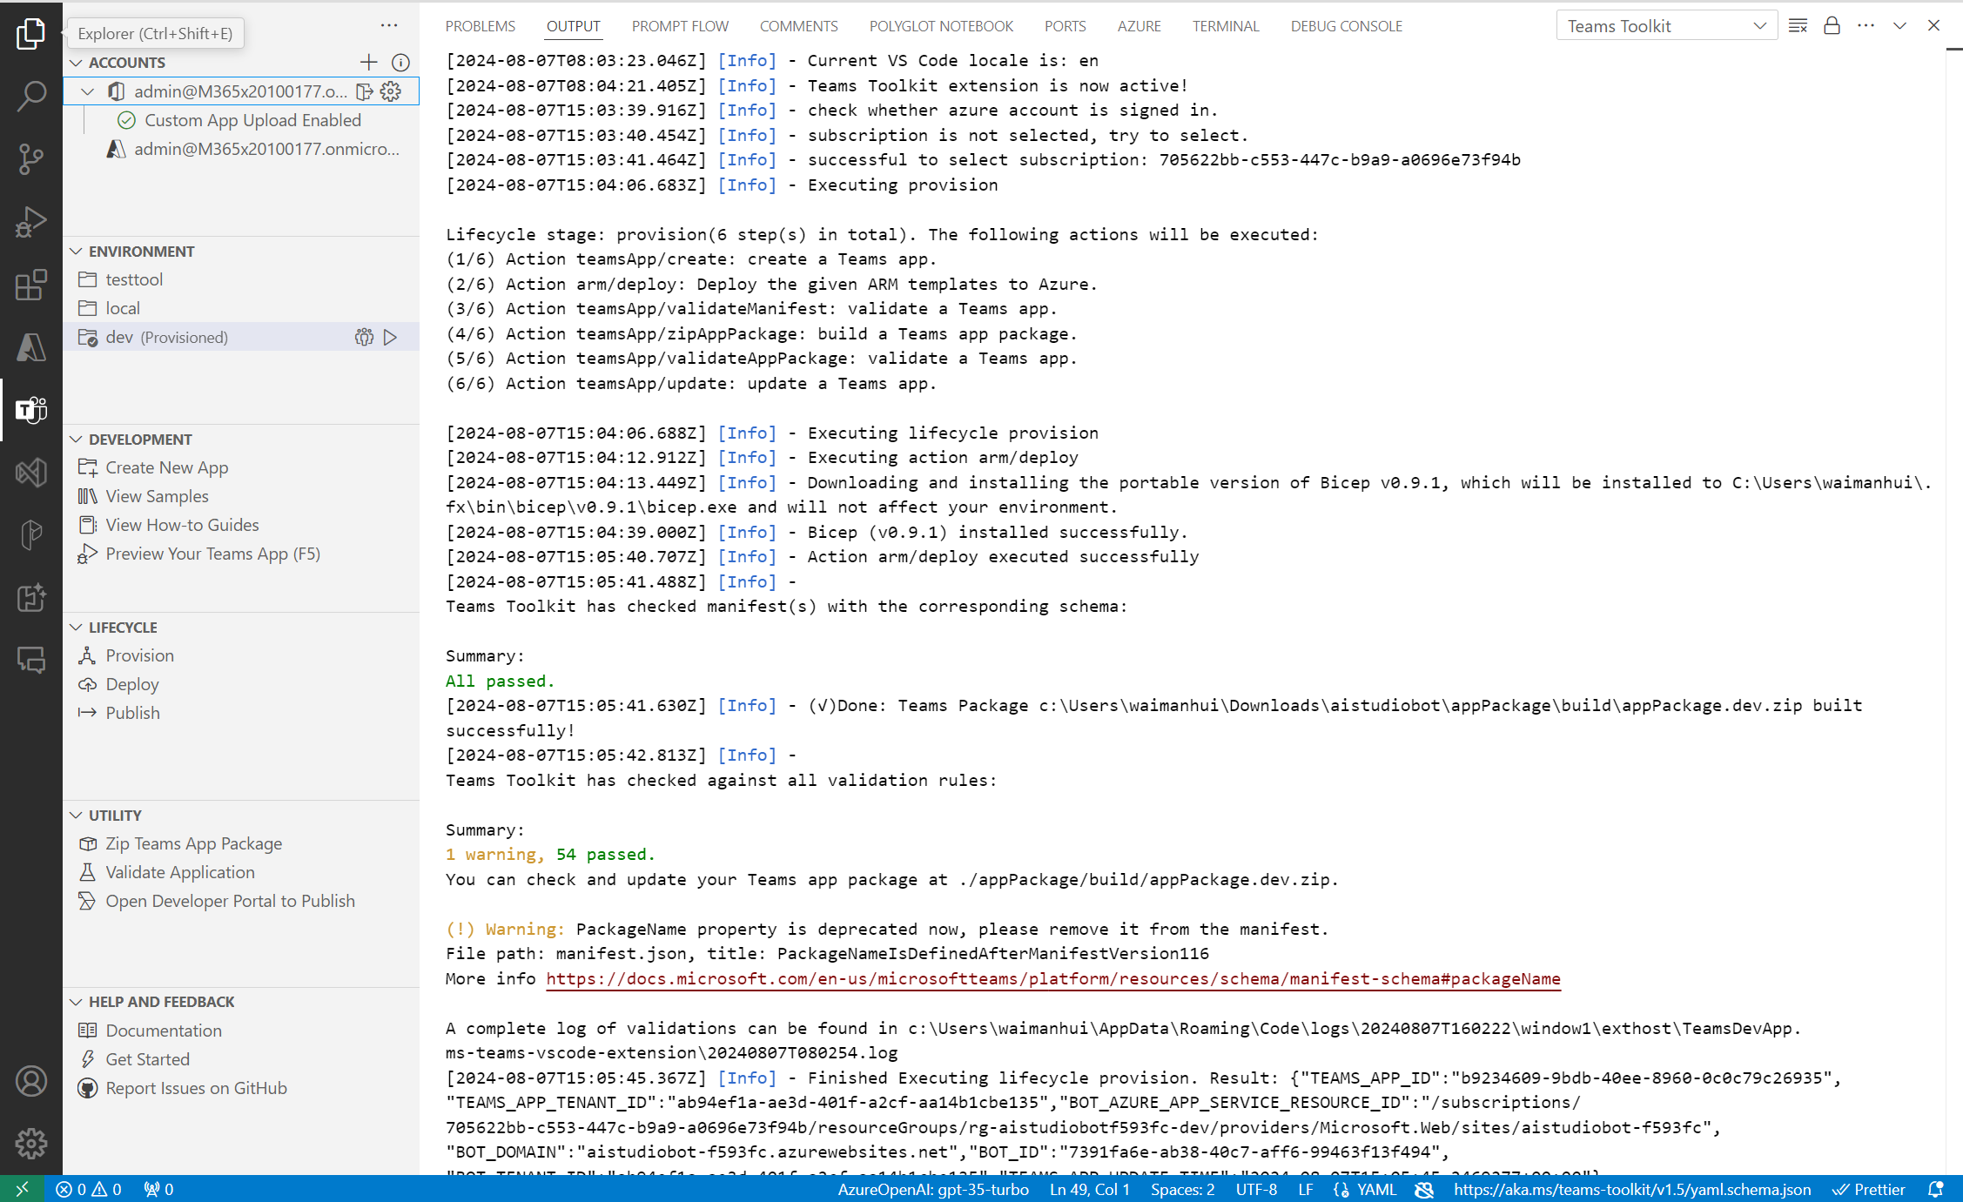

Slide 36
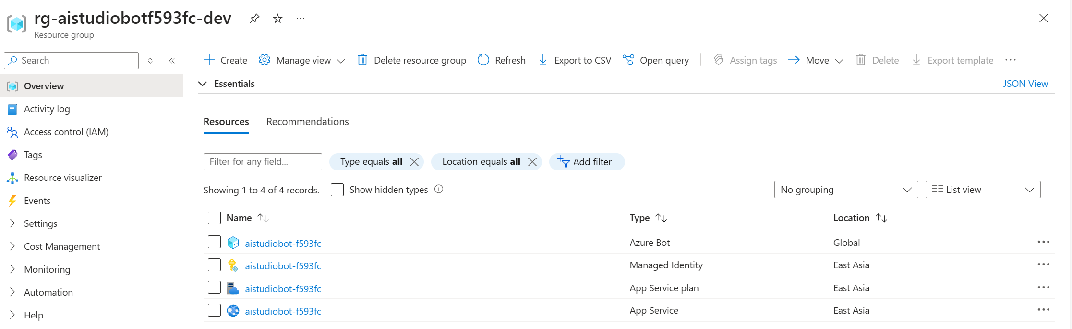

Slide 37
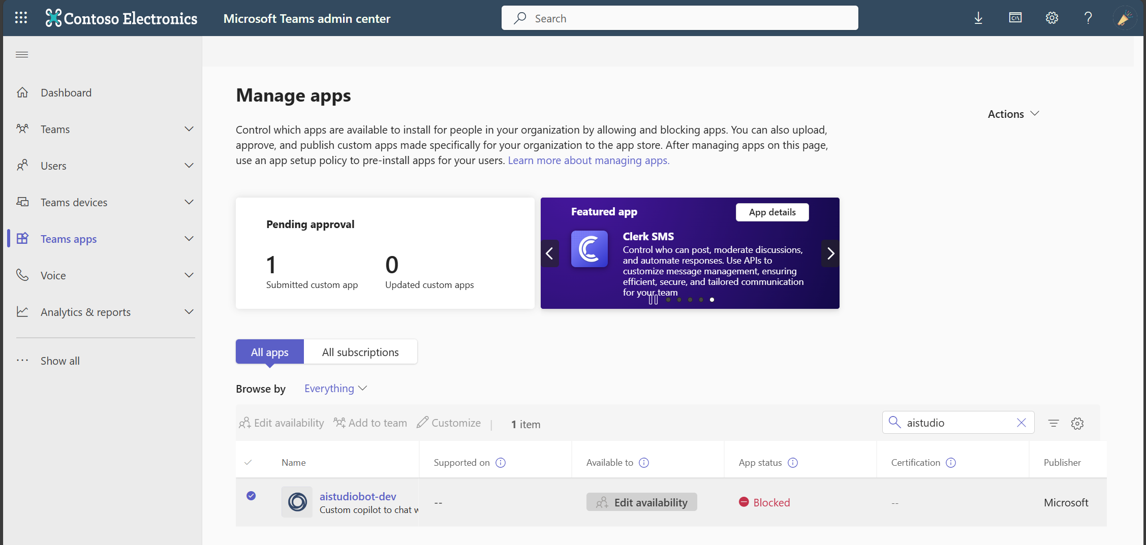

Slide 38
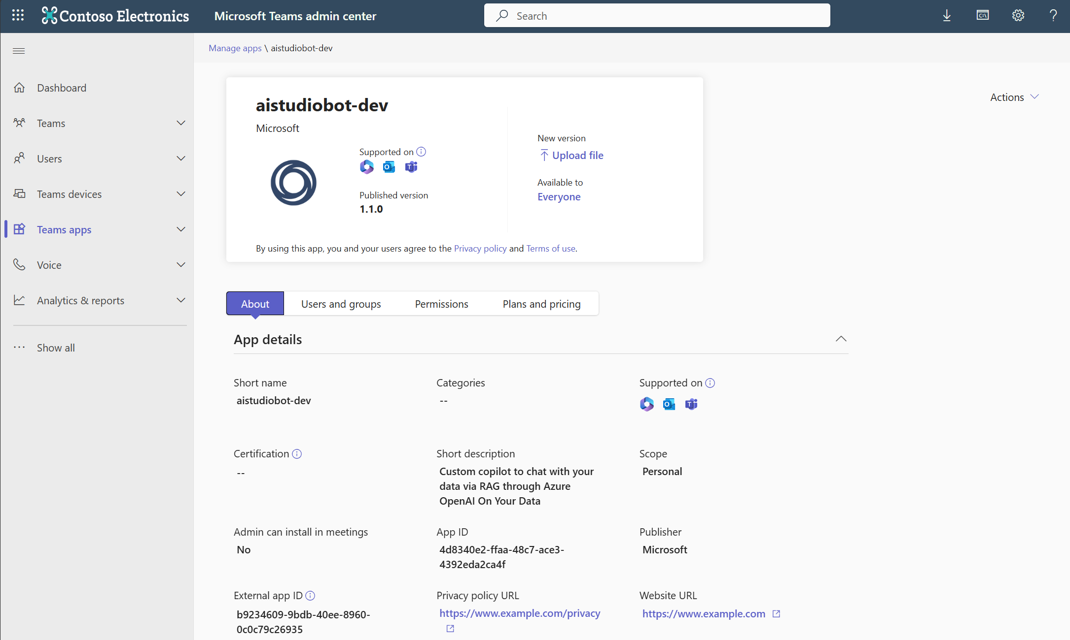

Slide 39
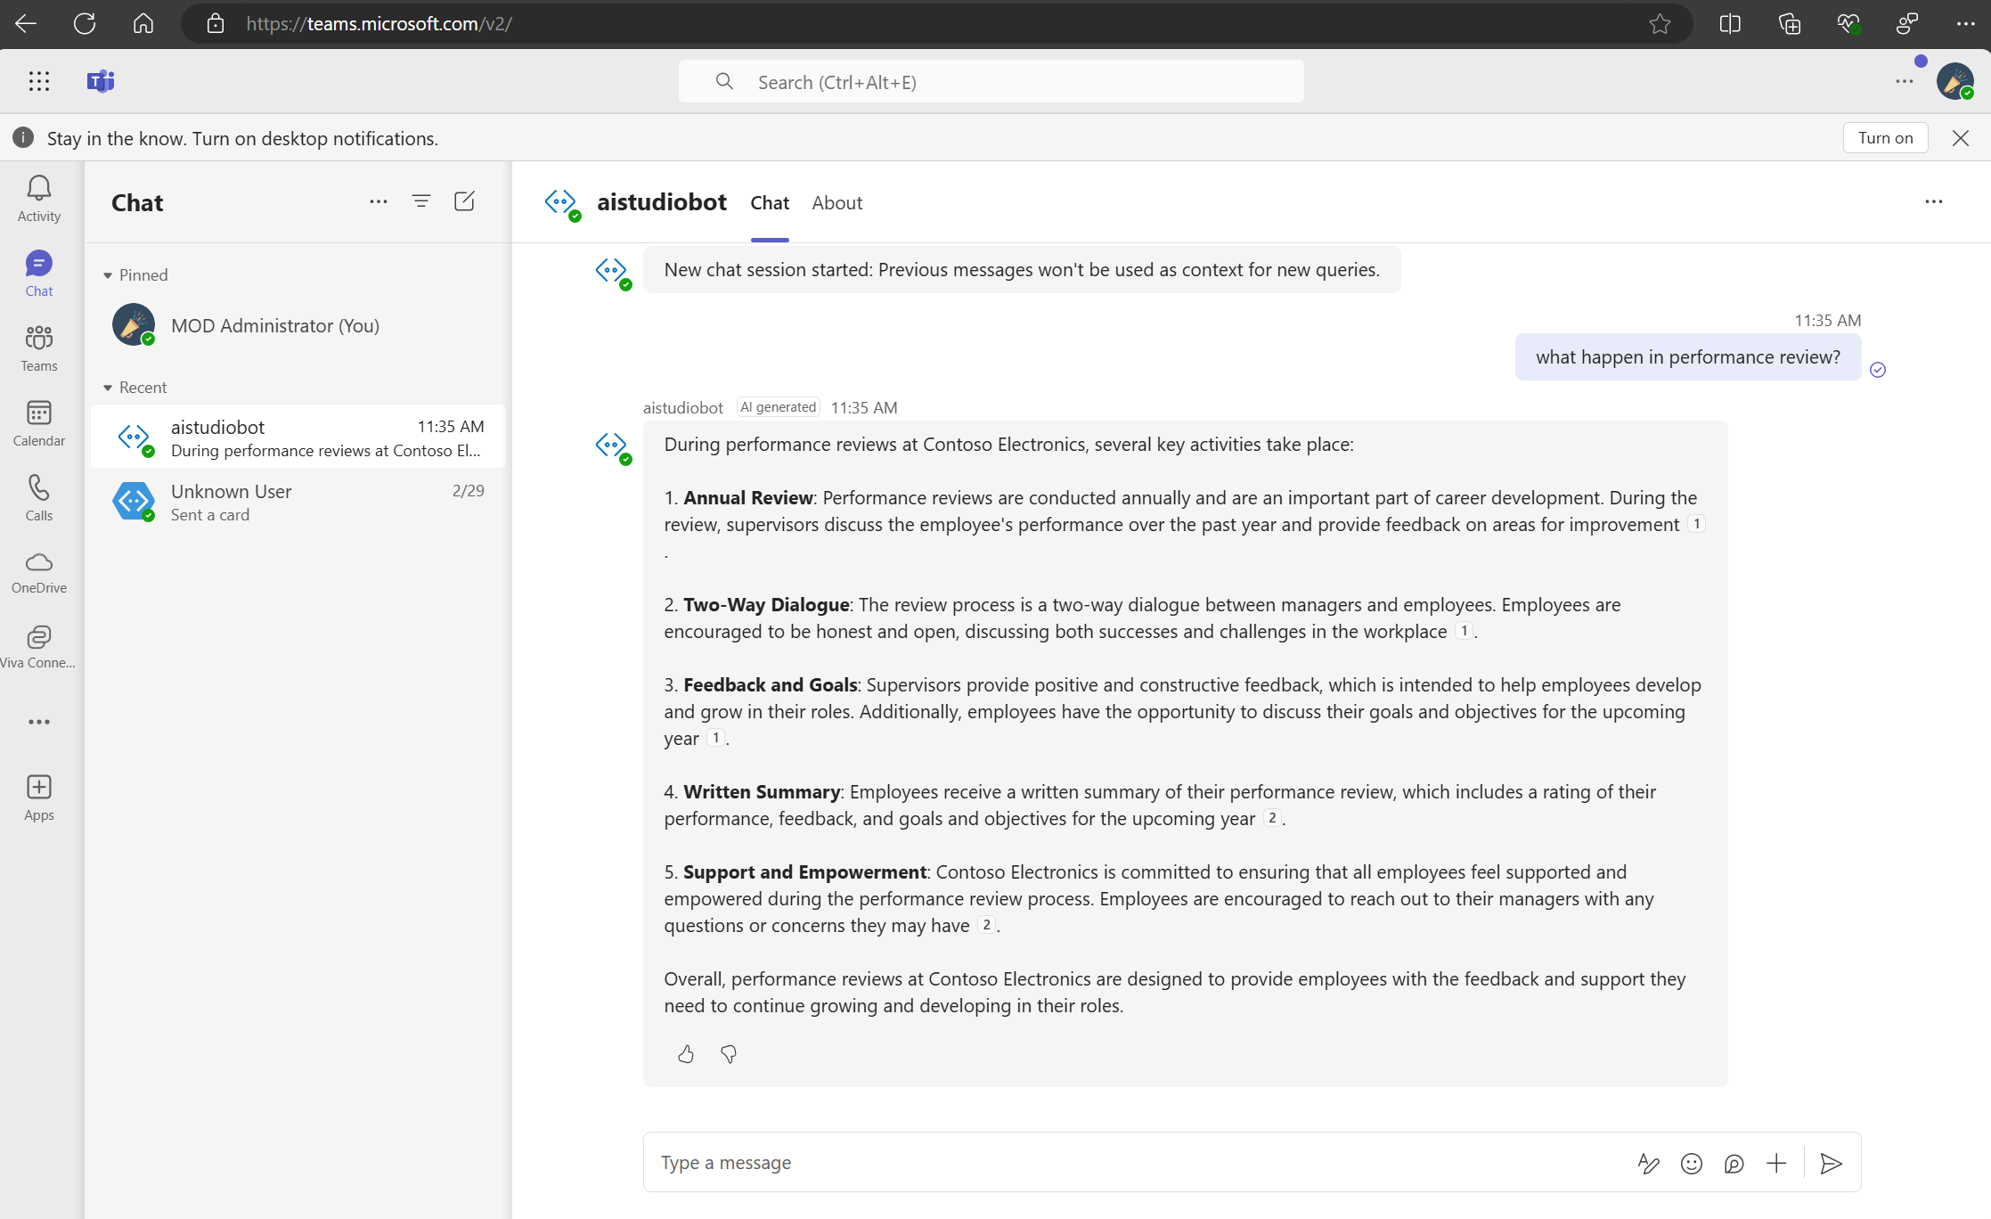

Slide 40
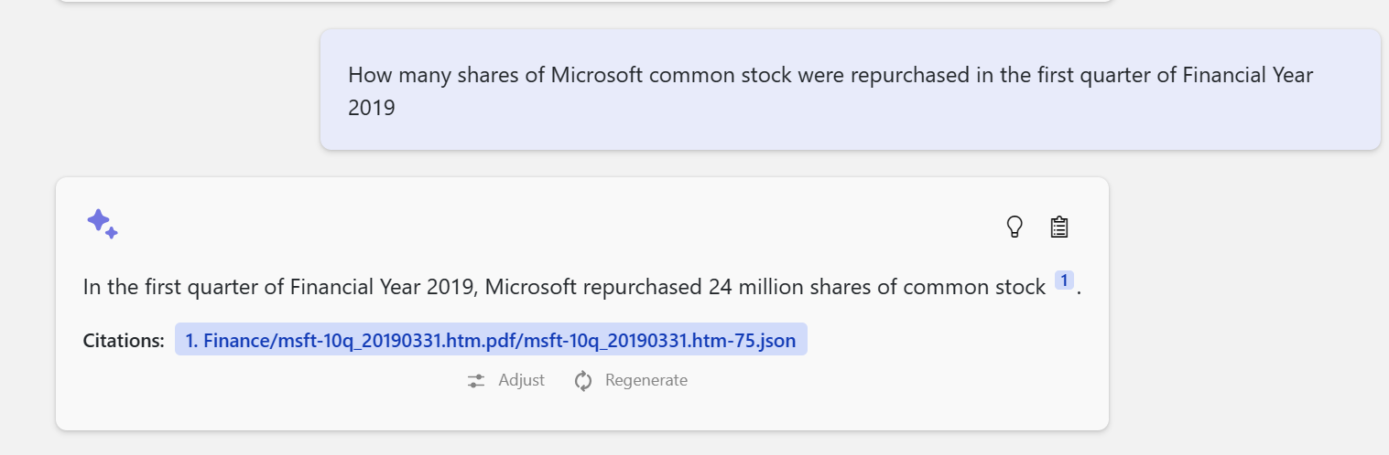
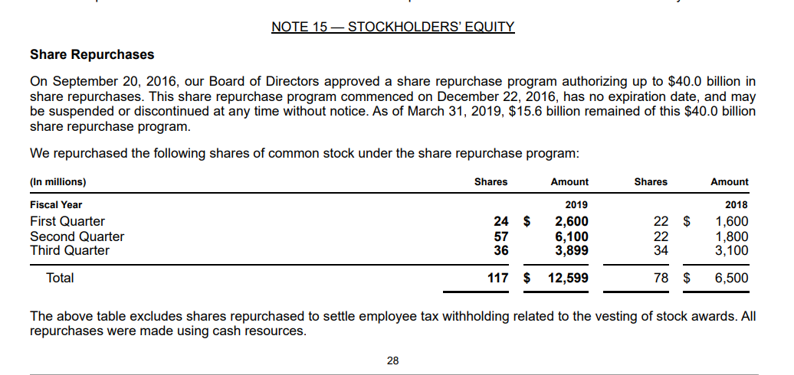
Information Assistant
https://aka.ms/InfoAssist

Slide 41
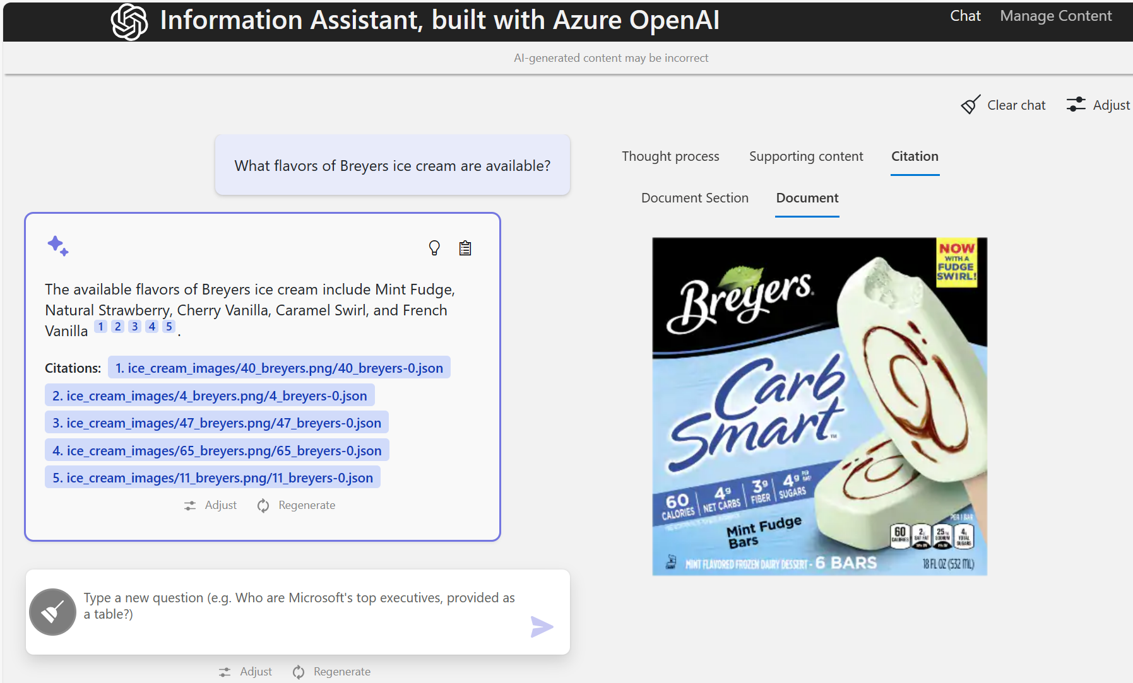
Information Assistant

Slide 42

GraphRAG

Slide 43
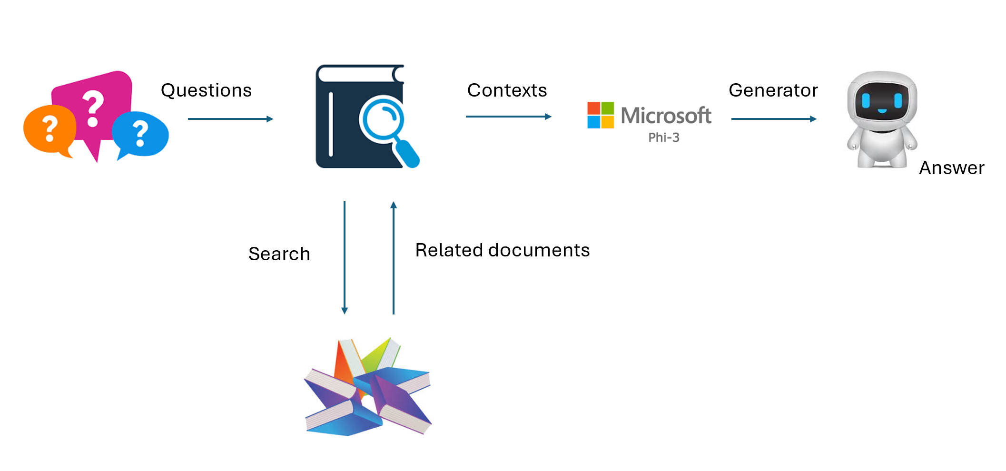
VECTOR-BASED RAG

Slide 44




VECTOR-BASED RAG Features
Similarity
Content relevance
Reasonable
Accuracy

Slide 45

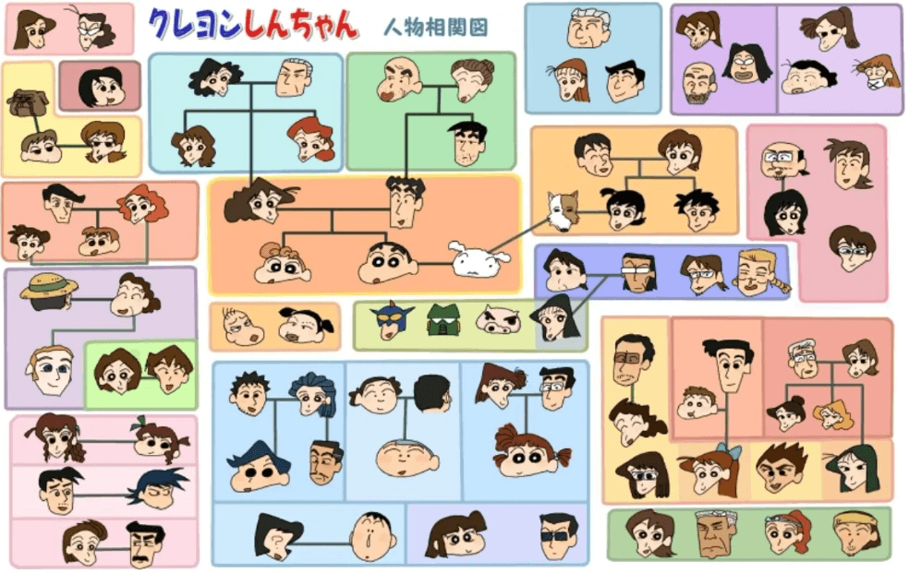
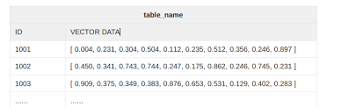
Understand your data

Slide 46

Chat with Your Data with RAG
VECTOR-BASED RAG
Vector-based RAG — like fine-tuning — increases the probability of the correct answer for many questions. However, neither technique guarantees the correct answer. They also tend to lack context, color, and connection to facts you know. Furthermore, these tools don’t leave you many clues about why they made a particular decision.
GRAPH RAG
1. Higher accuracy and more complete answers (runtime/production benefit)
2. Once the knowledge graph is created, it becomes easier to build and subsequently maintain RAG applications (development time benefit)
3. Better explainability, traceability, and access control (governance benefit)

Slide 47
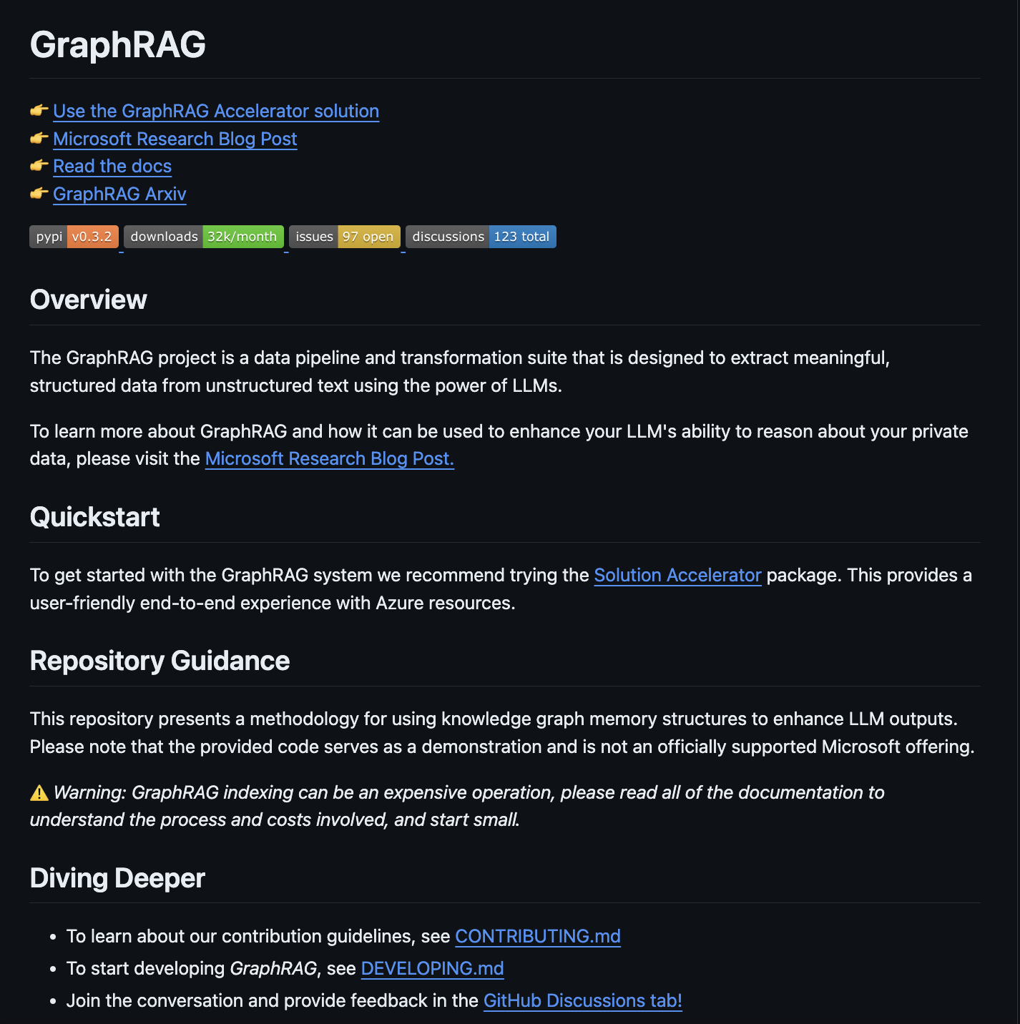
GraphRAG
https://microsoft.github.io/graphrag/

Slide 48
Gen Graph
Source Documents to Text Chunks: Source documents are divided into smaller text chunks for easier processing.
Text Chunks to Element Instances: Each text chunk is analyzed to identify and extract entities and relationships, resulting in a list of tuples that represent these elements.
Element Instances to Element Summaries: The extracted entities and relationships are summarized into descriptive text blocks for each element using the LLM.
Element Summaries to Graph Communities: These entities, relationships and summaries form a graph, which is subsequently partitioned into communities using algorithms using Heirarchical Leiden to establish a hierarchical structure.
Graph Communities to Community Summaries: The LLM generates summaries for each community, providing insights into the dataset’s overall topical structure and semantics.

Slide 49

DEMO

Slide 50
SLM ? Local ?

Slide 51

Experience

Slide 52
